Slide 1
Safety practices
Please be sure to watch this presentation as a Slide Show.

Slide 2
Welcome to this presentation on safety practices!
To receive credit for this training, please consider the following:
Complete the PowerPoint in its entirety.
Click on the Professional Development Participation Log link or scan the QR code at the end of this presentation. This is proof of your attendance.
As a team, complete an Active Supervision plan, a Safe Environment Checklist, the Safety & Emergency Preparedness Plan, and update your Grab & Go Binder.

Slide 3
Training Objectives & Goals
Understand the importance of implementing and adhering to safety practices.
Recognize safety standards set forth by the Office of Head Start and LARA.
Become familiar with new safety standards, policies, and procedures.
Review the importance of intentionally implementing Active Supervision strategies to support a safe learning environment for all children.
Review safety practices and policies related to pedestrians and transporting children to and from school.
Complete a Safe Environment Checklist to become aware of any safety needs or concerns in your learning environment as well as required postings.
Review and complete a Safety & Emergency Preparedness Plan to assist all staff with being prepared when an emergency occurs.

Slide 4
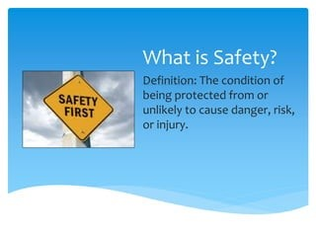
Safety: What is It?
Safety is everyone’s responsibility!
Early childhood programs that promote safety do the following:
Ensure environments are hazard free.
Have staff who are actively supervising and providing nurturing care to all children.
Everyone in the program actively and openly communicates about safety concerns.

Slide 5
Culture of Safety
In all early childhood programs, staff and families believe that children have the right to be safe by creating a culture of safety. They provide….
“an environment that encourages people to speak up about safety concerns , makes it safe to talk about mistakes and errors, and encourages learning from these events.”(1)
When everyone works together to improve safety strategies used in homes, centers, and the community, children are safer.
Programs that create a culture of safety promote school readiness and empower families to live safe and healthy lives.
1. Institute for Healthcare Improvement. (2016). PS 202: Building a culture of safety. Retrieved from http://app.ihi.org/lms/coursedetailview. aspx?CourseGUID=789d9cbb-7dd3-4fe9-8df2-e0c 63725b350&CatalogGUID=6cb1c614-884b-43ef9abd-d90849f183d4

Slide 6
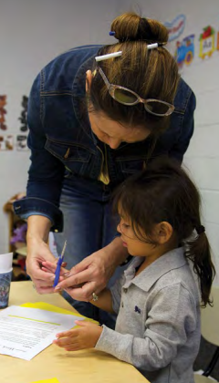
Culture of Safety: Why is It Important?
Young children’s rapid development and skill building is supported through exploration and experimentation.
Programs promote children’s healthy development by providing safe environments for children to be active and competent learners.
Young children are at higher risk for many types of injuries:
Falls, being hit by objects, stings, and chocking are common.
Unintentional injuries are the primary cause of death in young children; drowning tops the list.
Traumatic brain injuries are more likely to occur in children ages 0-4 years than any other age group!
Prevention is key and it works to keep children safe! On the next slide, take some time as a team to review “The 10 Actions for a Culture of Safety.”

Slide 7
10 Actions to Create a Culture of Safety

Slide 8
Safety Standards
Keeping children safe at all costs is absolutely best practice.
We are also required to be trained on and adhere to safety practices.
Please spend a few minutes on the next few slides reviewing the rules and regulations that we must abide by as they relate to safety.

Slide 9
Head Start Program Performance Standards
The HSPPS regulation regarding safety is 1302.47 Safety Practices. This regulation states the following:
(a) A program must establish, train staff on, implement, and enforce a system of health and safety practices that ensure children are kept safe at all times; and
(b) A program must develop and implement a system of management, including ongoing training, oversight, correction and continuous improvement in accordance with §1302.102, that includes policies and practices to ensure all facilities, equipment and materials, background checks, safety training, safety and hygiene practices and administrative safety procedures are adequate to ensure child safety.
Some areas of safety that must be addressed include the following:
Facilities
Equipment and materials
Background checks
Safety training (including Active Supervision and Pedestrian/Transportation Safety)
Disaster preparedness
Please take some time as a team to review and become familiar with this important standard. CLICK HERE to visit the ECLKC site. Please return to the PowerPoint presentation following review of the safety regulation.

Slide 10
Licensing and Regulatory Affairs
LARA, otherwise known as Licensing, also requires programs to adhere to strict safety rules and practices.
Some of these rules include the following:
R 400.8131 Professional Development
R 400.8170 Outdoor Play Area
R 400.8173 Equipment
R 400.8320 Food Preparation
R 400.8380 Maintenance of Premises
To review and become more familiar with Childcare Licensing Rules regarding safety, please CLICK HERE.

Slide 11
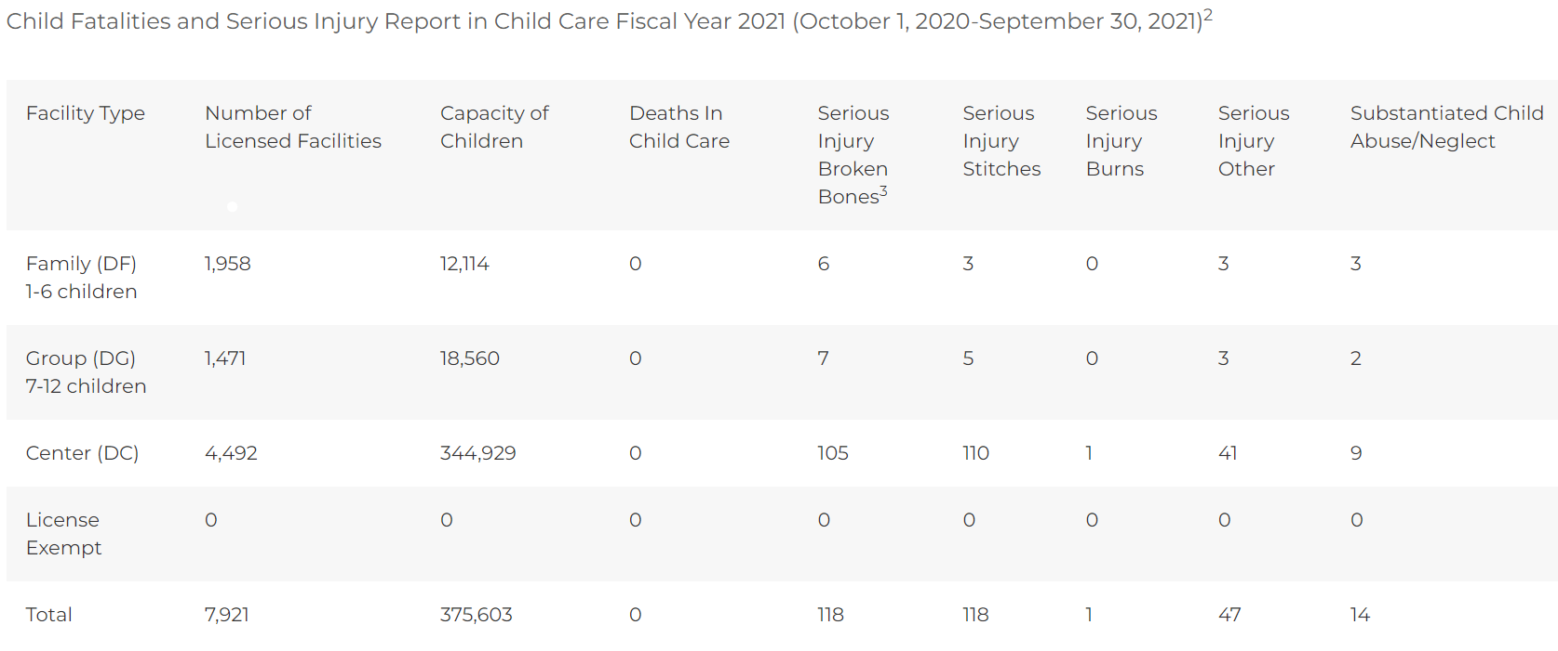
Safety Data
Unsafe practices may lead to children experiencing serious injuries.
Take a few minutes to review the included graph that details serious injury reports made to LARA during FY2021.

Slide 12
Special Investigations
A special investigation occurs when an allegation of a licensing rule violation is made. In particular, special investigations typically stem from accidents on site.
The investigation is completed by the State of Michigan Licensing and Regulatory Affairs, otherwise known as LARA or Child Care Licensing.
When a special investigation is initiated with LARA, this MAY also result in a special investigation by the Office of Head Start.
To learn more about Special Investigations, CLICK HERE for additional training.

Slide 13
NMCAA Safety Data
R 400.8143: Children’s Records
On two separate occasions, consultants (supervised volunteers) nearly took children out of the classroom in an unsupervised capacity. Neither consultant was listed on the children’s information record and approved for unsupervised release by their parents.
R 400.8152: Medication
During the inspection, a bottle of children's Benadryl was found for a 4-year-old which stated that it could not be given to a child between the ages of 2 and 5 years old without a doctor's authorization. There was not a doctor's authorization for this medication on site.
R 400.8161: Emergency Procedures
Staff were unable to locate the center’s crisis management plans.
R 400.8350: Toilets/Handwashing Sinks
The water temperature of the three sinks accessible to children in the women's bathroom were recorded at 120.6, 120.7, and 120.6.
*** REPEAT VIOLATION *** During the inspection, the water temperature in the men's restroom was recorded at 125.1- and 124.9-degrees F. Water temperature in the women's bathroom was recorded at 128.5- and 127.9-degrees F.
R 400.8380: Maintenance of Premises
Two large bottles of dish soap and several smaller bottles of hand soap were accessible to children in a cabinet under the handwashing sink in the classroom.
A cabinet within the children’s reach was unlocked and contained a variety of cleaning chemicals, creating a safety hazard.
Saran Wrap/Aluminum foil (which have sharp edges) were accessible to children.
R 400.8385: Toxic Materials
A spray bottle containing a flame-retardant chemical was accessible to children in the cupboard adjacent to the classroom door.
Included are some examples of safety violations that NMCAA programs have encountered in recent years:

Slide 14
Safety Practices Training
The remainder of this PowerPoint is divided up into four distinct areas of safety training:
Active Supervision
Pedestrian & Transportation Safety
Safe Environment Checklist & Required Postings
Safety & Emergency Preparedness/Grab & Go Binder
You must complete each safety section to receive credit for the whole training.
Please complete each section as a team.
You may choose to complete the entire training in one sitting, or you may choose to complete different sections on different days.
Training credit will not be awarded until each section, and the subsequent paperwork, is completed and submitted.

Slide 15
Active supervision
It’s time to review the six Active Supervision Strategies, explore the strengths and challenges that your classroom encounters, and create an Active Supervision Plan!

Slide 16
Active Supervision
Many of you have been implementing Active Supervision for several years. Way to go!
On the following slides, let’s take just a few minutes to review the importance of Active Supervision and its six strategies.

Slide 17
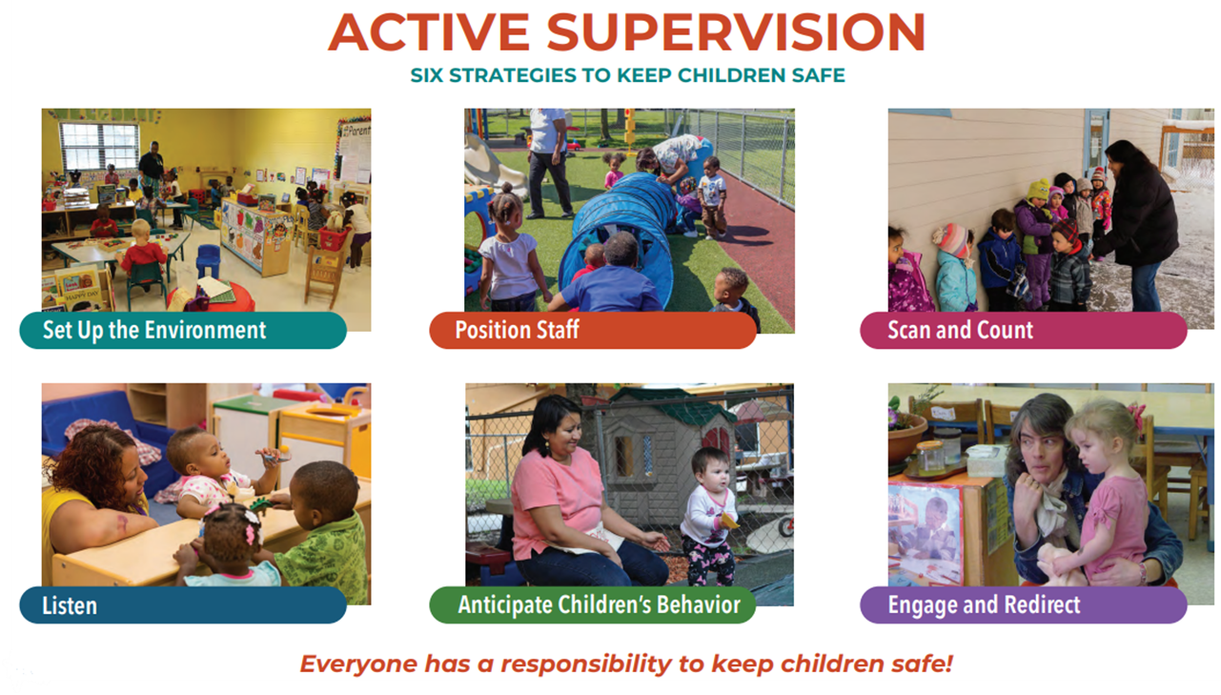
Active Supervision: What is It?
To ensure children are never left alone or unsupervised, staff position themselves so that they can observe, count, and listen at all times.
They use their knowledge of each child’s development and abilities to anticipate children’s behavior and redirect children when necessary.
Staff use active supervision in classrooms, on playgrounds and buses, and in all other early childhood environments.

Slide 18
Active Supervision: Why Does it Matter?
Young children are more likely to become injured when they are left unattended.
Lower levels of adult supervision are associated with higher odds of more severe injury in young children.
Having an attentive adult nearby is the best way to prevent injuries.
Staff need a systematic, easy-to-use process to set up the environment, observe, and interact with children to promote child safety.
Active supervision offers an effective strategy for adults to look, listen, and engage to prevent childhood injuries.

Slide 19
Active Supervision: Our Why!
Children’s safety is our top priority!
It’s a Head Start Performance Standards’ requirement:
1302.90 (c)(v) “Ensure no child is left alone or unsupervised by staff, consultants, contractors, or volunteers while under their care.”
It’s a Child Care Licensing requirement:
R 400.8125 (1) “All staff and volunteers shall provide appropriate care and supervision of children at all times.”
A lapse in active supervision will result in a special investigation by Licensing and possibly other authorities.
It promotes safety and helps to prevent injuries.
Safe environments = opportunities for children to actively engage! ☺

Slide 20
Active Supervision: The Six Strategies
Please take time to review these important strategies as a team!
Set Up the Environment
Set up the environment so you can supervise children at all times. When activities are grouped together and furniture is at waist height or lower, it is easier to see and hear children. Make sure small spaces are clutter free and big spaces are set up so that children have clear play areas that you can observe.
Position Staff
Plan where staff will position themselves to see and hear all of the children. Make sure there are always clear paths to where children are playing, sleeping, and eating so you can react quickly when necessary. Stay close to children who may need additional support so you can offer assistance when needed.
Scan and Count
To account for the children in your care, continually scan the entire environment to know where everyone is and what they are doing. Count the children frequently. This is especially important during transitions when children are moving from one location to another.
Listen
Specific sounds or the absence of them may signify reason for concern. Listen closely to children to identify signs of potential danger. Programs that think systemically implement additional strategies to safeguard children. For example, placing bells on doors can alert you when a child enters or leaves the room.
Anticipate Children’s Behavior
Use what you know about each child’s individual interests and skills to predict what they will do. Create challenges that children are ready for and support them so they can succeed. Recognize when children may get upset or take a dangerous risk. Use information from a daily health check (e.g., illness, allergies, lack of sleep or food) to anticipate children’s behavior. Knowing what to expect can help you protect children from harm.
Engage and Redirect
Know when to offer children support. Wait until children are unable to solve problems on their own to get involved. Offer different levels of assistance or redirection depending on each individual child’s needs.

Slide 21
Active Supervision & Families
Communicating regularly with families is key to developing nurturing relationships with children.
Ongoing communication with families, including checking in daily with each family, can help you plan for supervision.
Families can help you learn about their child’s interests, abilities, and needs, which helps you anticipate when to engage and redirect the children in your care.
Strong relationships with families helps you tailor your approaches and create partnerships that ensure children are safe at home and in your classroom.

Slide 22
Family Resources
Collaborating with families on Active Supervision occurs all throughout the year:
Sharing information at Orientation along with the Parent/Guardian Handbook.
Providing additional information and resources at Parent-Teacher Conferences, Home Visits, and in newsletters.
What other ways are you sharing Active Supervision with your families?
Resources:
Below are some helpful resources as it relates to Active Supervision and collaborating with families.
“Injury Prevention Starts at Home”
“Safety and Injury Prevention: Tips for Families”
“A Guide to Safety Conversations with Families”
Be sure to connect with your FES, supervisor, or coach for ideas and resources related to this important topic!

Slide 23
Staff Wellness Resources
REMEMBER: To effectively implement and be on top of your Active Supervision game, you MUST take care of you FIRST!
NMCAA offers a variety of resources to support staff on their wellness journey.
Employee Assistance Program
Wellness Coach
Starling Minds
NONI
ECLKC also provides a variety of resources to explore.

Slide 24
Let’s Brainstorm
Take some time as a team to reflect on the six Active Supervision strategies.
What practices do you have in place that work really well and support the different strategies?
What challenges do you face?
Now let’s share with the rest of the Child and Family Development team.
Click on the Whiteboard link below. This will take you to an outside browser. Add your thoughts on the relevant sticky notes under each section.
This will be accessible to ALL classroom staff. What a great way to share with one another about Active Supervision.
Ready to get started?
CLICK HERE

Slide 25
Active Supervision: Next Steps
Now that you’ve had time to review and reflect on your Active Supervision practices, it’s time to plan for the upcoming program year.
Please refer to the following slides for required postings and forms to be completed prior to the start of the program year.

Slide 26
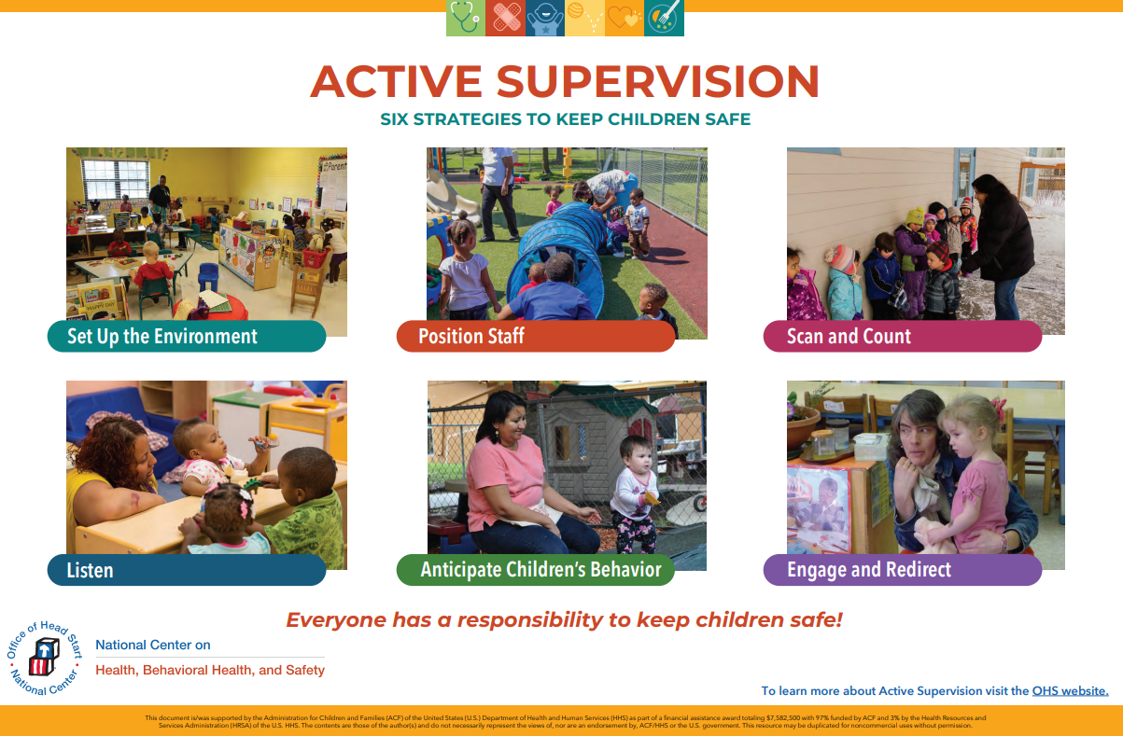
Active Supervision Postings
Active Supervision Poster
Be sure to display this poster during Start Up; make sure it’s easily visible!
Need a new poster?
NMCAA HS Weebly
ECLKC

Slide 27
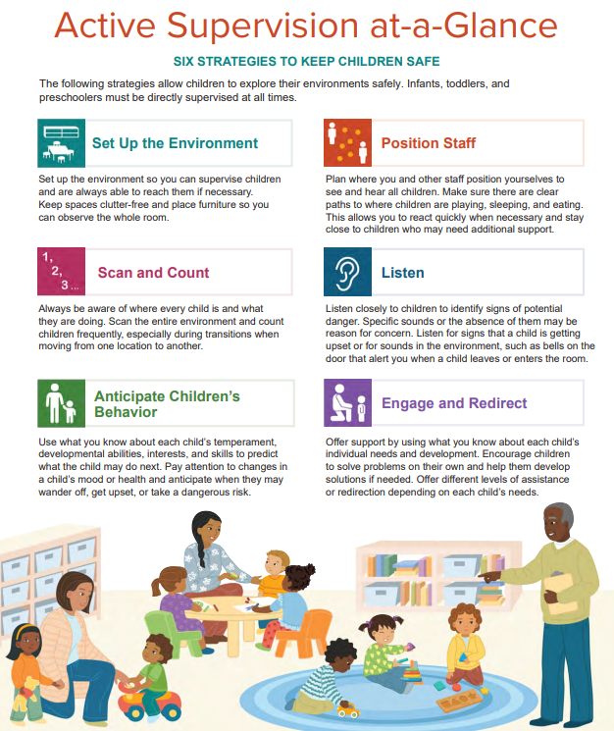
Active Supervision Postings
Active Supervision At-A-Glance
This optional posting provides a quick reference for the six Active Supervision strategies.
Need a new poster?
NMCAA HS Weebly
ECLKC

Slide 28
Active Supervision Plan
As a team, please take time to complete an updated Active Supervision Plan for the upcoming program year.
Components of the Active Supervision Plan include the following:
Zoning to Maximize Learning: Discussion Questions
Zoning to Maximize Learning: Staff Zoning Chart
Active Supervision Implementation Plan
Classroom Maps: Indoor & Outdoor Spaces
Classroom Transitions: Planning for Transitions
Please refer to the next screen for additional resources while completing your plan.
Be sure to keep your plan in your Green Grab & Go Binder.
Please contact your supervisor with any questions or concerns.
Lead Teachers: Now is the time to pull out your Active Supervision plan!

Slide 29
Active Supervision Additional Resources
Please refer to these additional resources while completing your Active Supervision plan:
Active Supervision Toolkit
Tips for Teachers: Classroom Transitions
Tips for Teachers: Zoning to Maximize Learning
Tips for Teachers: Designing Environments
Tools for Supervisors: Supporting Positive Behaviors During Classroom Transitions
NMCAA Head Start Weebly Site
ECLKC

Slide 30
Active Supervision: Final Thoughts
We are ALL responsible for the health and safety of ALL children while they are in our care.
Active supervision is a critical piece to ensuring that ALL children have opportunity to explore and learn in a caring, responsive, and safe environment!
Creating an Active Supervision Plan is an intentional process that should include everyone on the team.
Please be sure to place your completed Active Supervision Plan in your green Grab & Go binder.
Remember to send a copy of your completed plan to your supervisor.
Reminder: As the year goes along, changes are sure to happen! Pull out your Active Supervision Plan to review and make adjustments, as needed.
Up Next:
Pedestrian and Transportation Safety

Slide 31
PEDESTRIAN & TRANSPORTATION SAFETY
Next, let’s explore facts and resources related to pedestrian and transportation safety.
ALL sites are required to complete this training, regardless of transportation at your program.

Slide 32
Why Pedestrian Safety?
Pedestrian safety is an important topic! We want to help make sure that all the children and families in our programs stay safe.
It’s also a part of the Head Start Program Performance Standards!
1302.46 Family support services for health, nutrition, and mental health.
(b) Opportunities. (1) Such collaboration must include opportunities for parents to:
(v) Learn about appropriate vehicle and pedestrian safety for keeping children safe.
Let’s explore some more pedestrian safety information and learn what our roles are related to supporting children and families with this important safety topic!

Slide 33
Pedestrian Accident Facts
81
81: A pedestrian was killed, on average, every 81 minutes in traffic crashes in 2020.
Other statistics from 2020 include the following:
A pedestrian was injured every 10 minutes.
Pedestrian-related traffic crashes caused 6,516 deaths.
54,769 pedestrians were injured.
16% of the children 14 years and younger who were killed in traffic crashes were pedestrians.

Slide 34
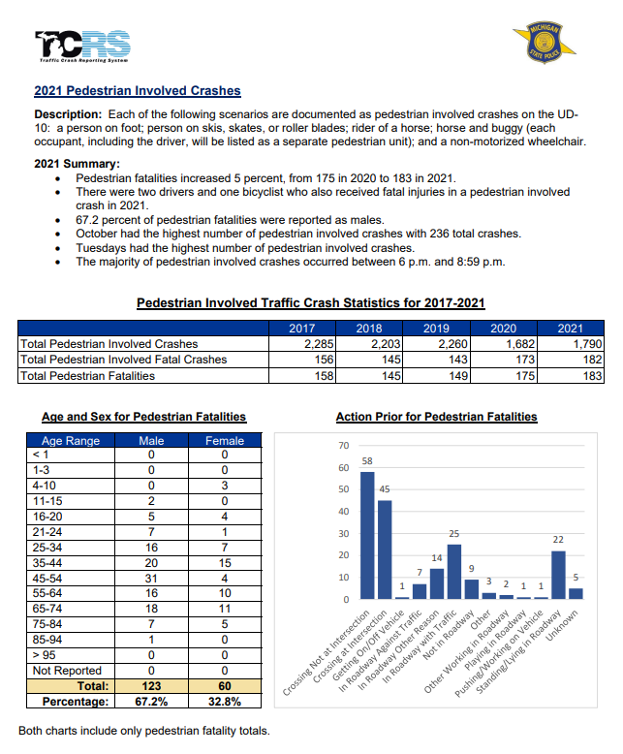
Michigan Facts
Here is data specific to the State of Michigan.
For more information, check out www.michigan.gov/ohsp

Slide 35
Pedestrian Safety & Young Children
Growth and Development Key Points
Children need to be able to choose the safest places to walk.
Children need to learn where to cross streets and how to cross safely.
Children will demonstrate these skills some of the time, so continued practice is needed.
Attention and concentration skills are essential for safe walking and develop as children mature.
Children: 4 to 6 years old
Need supervision
Are ready to practice the basics
May do the unexpected
Need adults to model safe walking behavior

Slide 36
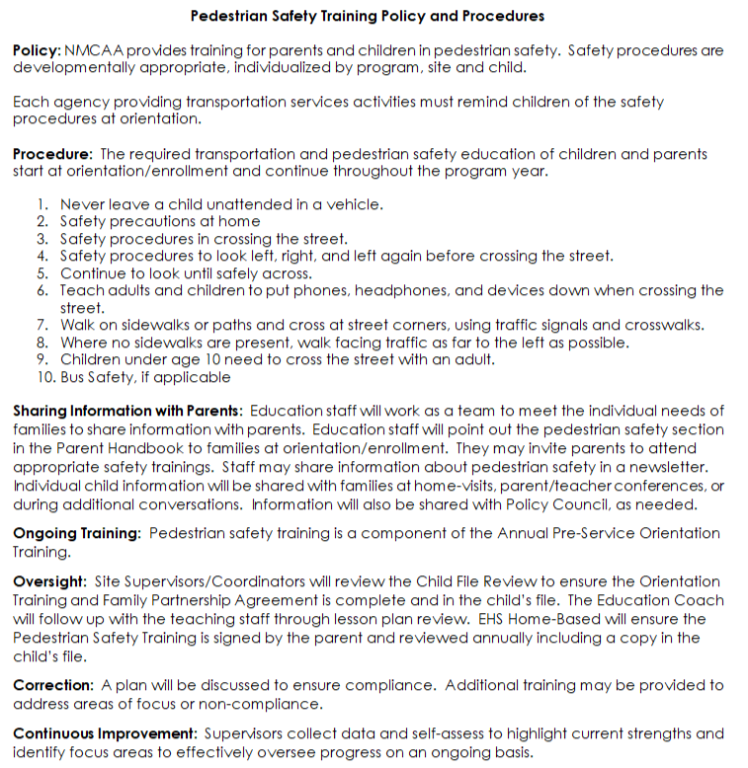
NMCAA Pedestrian Safety Training Policy & Procedures
Please take time now as a team to review the most up-to-date version of NMCAA’s Pedestrian Safety Training Policy & Procedures.
Take turns as a team reading each paragraph/section out loud.

Slide 37
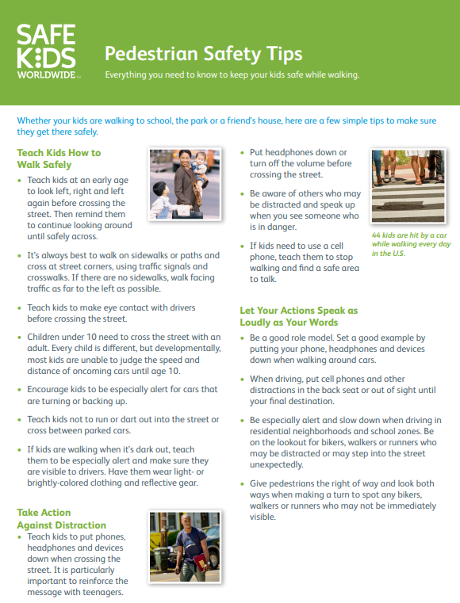
Pedestrian Safety Training Process
Pedestrian safety occurs all throughout the year with children and families:
Sharing information at Orientation along with the Parent Handbook.
Providing additional information and resources during Parent-Teacher Conferences, Home Visits, and in newsletters.
This tip sheet will be shared with families at the first home visit. Look to your education coach for more guidance on this.
Intentionally planning activities and putting out materials to support children’s knowledge on this topic.
Be sure to connect with your education coach for ideas and resources related to this important topic!

Slide 38
Transportation Safety
Transportation safety is dictated by both Head Start and Licensing regulations:
Head Start
1303.74 Safety procedures.
(a) A program must ensure children who receive transportation services are taught safe riding practices, safety procedures for boarding and leaving the vehicle and for crossing the street to and from the vehicle at stops, recognition of the danger zones around the vehicle, and emergency evacuation procedures, including participating in an emergency evacuation drill conducted on the vehicle the child will be riding.
(b) A program that provides transportation services must ensure at least two bus evacuation drills in addition to the one required under paragraph (a) of this section are conducted during the program year.
Licensing
R 400.8710 Transportation.
R 400.8720 All motor vehicles.
R 400.8730 Safety equipment in motor vehicles.
R 400.8740 Manufacturer’s rated seating capacity; restraint devices; safety belts.
R 400.8750 Motor vehicle operator.
R 400.8760 Staff and volunteer-to-child ratio and supervision in transit.
R 400.8770 Time limitation on child transit.

Slide 39
Transportation Safety & Active Supervision
Just as in different learning environments, Active Supervision is an integral part of keeping children safe as they are being transported to and from school.
Active Supervision is EVERYONE’S responsibility!
We are all tasked with ensuring children’s safety.
Active Supervision is not just for those who ride Transit or Agency buses.
It’s important to work with parents and local school districts to promote transportation safety to and from school.

Slide 40
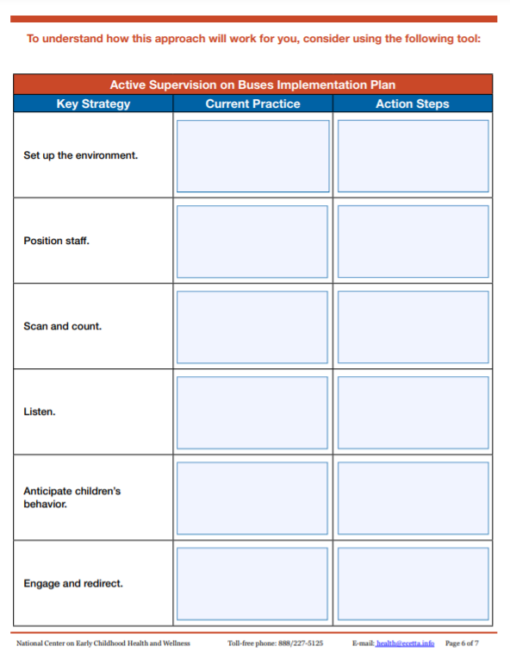
Active Supervision Planning
Look!
Take a look at this form on the right.
Look familiar?
That’s right! Creating an intentional plan for Active Supervision on the bus is just as important as the plans you make for your indoor and outdoor learning environments!
It’s important!
Even if children ride district buses, these six strategies still apply.

Slide 41
Transportation Safety Education
In addition to actively supervising children as they are transported to and from school, we must also be sure to help children learn safe riding practices, as well as safe ways to board and leave the bus.
Talk with children about being safe while they are on the bus. What are the expectations for being safe?
Engaging children throughout their daily routine with books and other activities related to bus safety.
Providing resources for families so everyone is on the same page regarding bus safety.
Thinking about your processes, how does your team ensure children learn all these important safety practices? Take a few minutes to reflect as a team on your strategies.

Slide 42
Transportation Policies & Procedures
NMCAA has other policies and procedures related to transportation services.
Please take time to review and become familiar with the documents included on the following slides.
Be sure to follow up with your supervisor regarding any questions or concerns you have on any of these documents or policies.
Transportation Types
Self-Transportation
NMCAA Bussing
Transit
Public School District

Slide 43
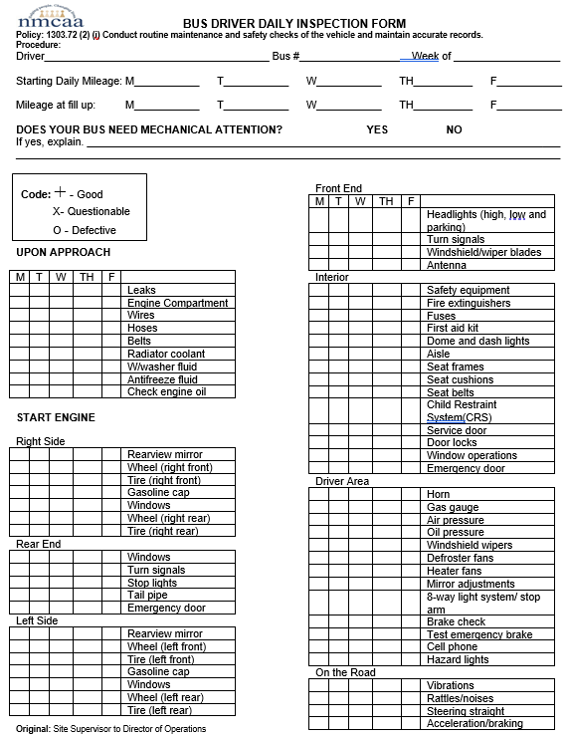
NMCAA Bussing
WHAT
Please take time to review the following form:
Bus Driver Daily Inspection Form
WHEN
REMEMBER!
This must be completed daily.
This must be sent to your site supervisor and the Director of Operations.

Slide 44
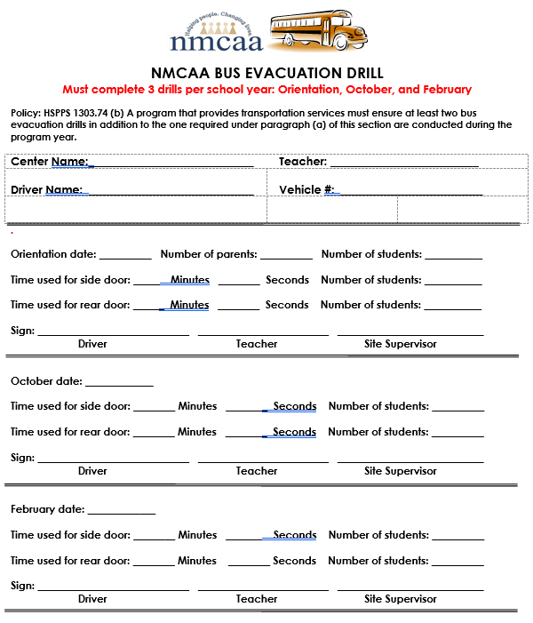
NMCAA Bussing and Transit-Required Forms to be Completed
Please take time as a team to review the following document:
NMCAA Bus Evacuation Drill
REMEMBER
This must be completed 3 times/year.
This must be sent to your site supervisor and Director of Operations.
Keep the original copy on site.

Slide 45
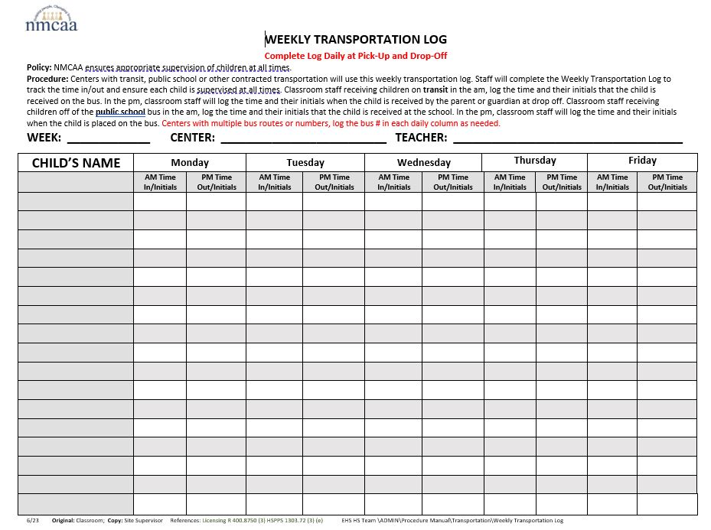
NMCAA Bussing, Transit, Public School District: Required Forms to be Completed
Please take time as a team to review the following document:
REMEMBER: This must be sent to your site supervisor at the end of each month with your What’s Due When paperwork.
Weekly Transportation Log

Slide 46
ALL SITES
Please take time to review and become familiar with the following two documents as a team:
Bus Procedures in Emergency Situations
Transportation Safety Procedures
REMEMBER
These must be reviewed and signed by all staff, including subs.
These must be posted at your site regardless of self-transportation.

Slide 47
Pedestrian & Transportation Safety: Final Thoughts
Remember: Teaching children about pedestrian and transportation safety is not only a requirement, but also another important piece to keeping children safe while in our care.
Be sure to check out all the additional pedestrian and transportation safety resources on Weebly and on the SharePoint PD page.
UP NEXT: Safe Environment Checklist

Slide 48
Safe environment checklist
Let’s take some time to explore NMCAA’s Safe Environment Checklist, its importance, and relevant updates and changes.

Slide 49
Safe Environments: Why Does it Matter?
Feeling safe and secure is important to all of us…even as adults!
Children depend on us to help keep them safe and out of harm’s way.
When children feel safe, they are more likely to build important, trusting relationships.
When children do not feel safe, this creates a barrier to active learning and children reaching their potential.
Understanding the importance of keeping all children safe, and what safe environments look like, are important steps to providing a space where children can grow, learn and thrive.

Slide 50
Safe Environment Checklist
The Safe Environment Checklist is a compilation of rules and regulations that align with the Office of Head Start and LARA’s safety standards.
Goals related to completion of the checklist include the following:
Staff are versed in safety rules and regulations.
Staff are aware of new requirements related to safety protocols.
Safety issues are addressed and rectified before and throughout the program year.
Staff are prepared for visits from their Licensing consultant.
Children are ensured safe environments in which they can actively engage.

Slide 51
Safe Environment Checklist Steps
Classroom staff must complete the SEC twice each program year.
As a team, complete all applicable sections in the checklist.
Be sure to look for what each indicator is asking and ensure that all required pieces are in place.
Make notes of any findings and be sure to share them with your supervisor.
Now is the time to pull out your Safe Environment Checklist!

Slide 52
Safety & emergency preparedness plan and Grab & Go Binder
Now it’s time to explore NMCAA’s Safety & Emergency Preparedness Plan, Grab & Go Binder, their contents, and why they’re important!

Slide 53
Safety Preparedness: Why Does it Matter?
Emergencies can happen in a blink of an eye. Emergency preparedness is the process of taking steps to ensure that all involved are safe before, during, and after an emergency.
There are three focus areas related to emergency management:
Preparedness: This takes place prior to an emergency. This involves being informed about any possible emergencies, creating plans to respond to emergencies, and collecting necessary supplies needed during emergencies.
Response: This begins the moment you become aware an emergency is imminent and continues as the emergency occurs.
Recovery: This begins as soon as the emergency is over. Recovery efforts tend to focus on such things as shelter, health and emotional needs, and food/water.
Early childhood staff play pivotal roles in supporting children during all three phases of emergency management.

Slide 54
Safety & Emergency Preparedness Plan
The Safety & Emergency Preparedness Plan was developed to support staff with unforeseen events and emergencies.
Goals related to this plan include the following:
Provide practical guidelines that enable staff to properly prepare and respond to a variety of emergency situations.
Enable all involved to protect the health and well-being of staff and clients.
Be prepared to secure the facilities and infrastructure.
Maintain/resume program operations when incidents occur.

Slide 55
Safety & Emergency Preparedness Plan Steps
Pull out last year’s Safety & Emergency Preparedness Plan as a reference. Be sure to access a new template to complete this year’s plan. CLICK HERE for the template.
The Safety & Emergency Preparedness Plan must be completed as a team prior to the start of the program year. Be sure to invite all team members who work in the building (EHS, R&H, FES, etc.) and building collaborators to assist in completing the Safety & Emergency Preparedness Plan.
Be sure to review each section for emergency instructions and guidance.
Document contact information and emergency protocols throughout the plan.
Completed plans must be submitted to jmcnally@nmcaa.net and your supervisor.
Completed plans will be housed in the documents section of our payroll system.
The plan should be reviewed when the second Safe Environment Checklist is completed. Any changes should be updated as they occur throughout the year.

Slide 56
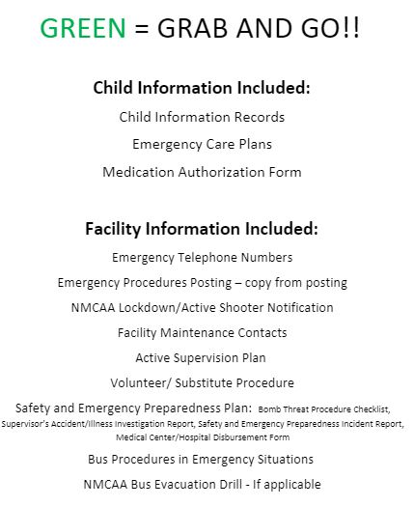
Grab & Go Binder
The Grab & Go Binder is intended to house important documents that are easily accessible to all staff.
It’s a “portable” filing system intended to be used “on-the-go.”
This could be in the classroom, on the playground, on a field trip, etc.
It’s important to ensure that your Grab & Go Binder is up-to-date with all the current completed forms, plans, and procedures.
As a team, take time to review the Grab & Go Binder’s required contents, and update it with the necessary completed forms, plans, and procedures.
Refer to Weebly or the SharePoint PD page for required forms and documents.

Slide 57
Remember…..
Complete
Active Supervision Plan
Review and Sign
Bus & Transportation Safety procedures documents
Complete
Safe Environment Checklist
Complete
All required postings; be sure to sign or initial as needed
Complete
Safety & Emergency Preparedness Plan and update your Grab & Go Binder.
Share
Be sure to share your completed plans and checklists with your supervisor and all others noted throughout the training.

Slide 58
Final Training Steps
Complete a Professional Development Participation Log (for attendance).
Please use the following training title:
Safety Practices Team Training
You will receive 6 training hours.
Please click on the following LINK to access the PD log or scan the included QR code.

Slide 59
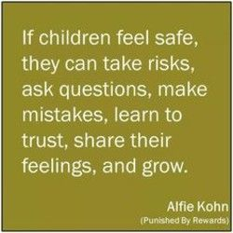
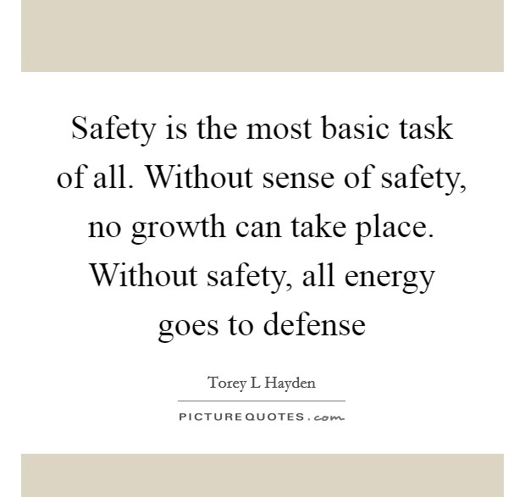
The End!
Thank you for your commitment to creating a safe space in which children can actively engage, grow, and develop!

