Slide 1
Safety practices Overview for New staff
Please be sure to watch this presentation as a Slide Show.

Slide 2
Welcome to this presentation on safety practices!
To receive credit for this training, please consider the following:
Complete the PowerPoint in its entirety.
Click on the Professional Development Participation Log link or scan the QR code at the end of this presentation. This is proof of your attendance.
Check in with your team on your classroom’s Active Supervision plan, Safe Environment Checklist, the Safety & Emergency Preparedness Plan, and your Grab & Go Binder.

Slide 3
Training Objectives & Goals
Understand the importance of implementing and adhering to safety practices.
Recognize safety standards set forth by the Office of Head Start and LARA.
Become familiar with safety standards, policies, and procedures.
Review the importance of intentionally implementing Active Supervision strategies to support a safe learning environment for all children.
Review safety practices and policies related to pedestrians and transporting children to and from school.
Review a Safe Environment Checklist to become aware of safety requirements in the learning environment as well as required postings.
Review your classroom’s Safety & Emergency Preparedness Plan to assist with being prepared when an emergency occurs.

Slide 4
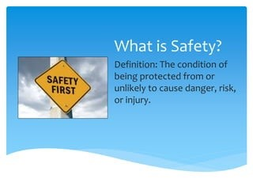
Safety: What is It?
Safety is everyone’s responsibility!
Early childhood programs that promote safety do the following:
Ensure environments are hazard free.
Have staff who are actively supervising and providing nurturing care to all children.
Everyone in the program actively and openly communicates about safety concerns.

Slide 5
Culture of Safety
In all early childhood programs, staff and families believe that children have the right to be safe by creating a culture of safety. They provide….
“an environment that encourages people to speak up about safety concerns , makes it safe to talk about mistakes and errors, and encourages learning from these events.”(1)
When everyone works together to improve safety strategies used in homes, centers, and the community, children are safer.
Programs that create a culture of safety promote school readiness and empower families to live safe and healthy lives.
1. Institute for Healthcare Improvement. (2016). PS 202: Building a culture of safety. Retrieved from http://app.ihi.org/lms/coursedetailview. aspx?CourseGUID=789d9cbb-7dd3-4fe9-8df2-e0c 63725b350&CatalogGUID=6cb1c614-884b-43ef9abd-d90849f183d4

Slide 6
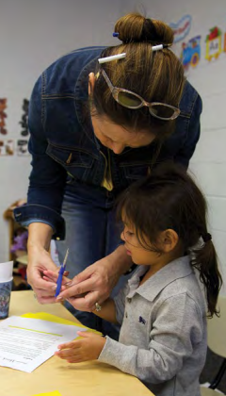
Culture of Safety: Why is It Important?
Young children’s rapid development and skill building is supported through exploration and experimentation.
Programs promote children’s healthy development by providing safe environments for children to be active and competent learners.
Young children are at higher risk for many types of injuries:
Falls, being hit by objects, stings, and chocking are common.
Unintentional injuries are the primary cause of death in young children; drowning tops the list.
Traumatic brain injuries are more likely to occur in children ages 0-4 years than any other age group!
Prevention is key and it works to keep children safe! On the next slide, take some time as a team to review “The 10 Actions for a Culture of Safety.”

Slide 7
10 Actions to Create a Culture of Safety

Slide 8
Safety Standards
Keeping children safe at all costs is absolutely best practice.
We are also required to be trained on and adhere to safety practices.
Please spend a few minutes on the next few slides reviewing the rules and regulations that we must abide by as they relate to safety.

Slide 9
Head Start Program Performance Standards
The HSPPS regulation regarding safety is 1302.47 Safety Practices. This regulation states the following:
(a) A program must establish, train staff on, implement, and enforce a system of health and safety practices that ensure children are kept safe at all times; and
(b) A program must develop and implement a system of management, including ongoing training, oversight, correction and continuous improvement in accordance with §1302.102, that includes policies and practices to ensure all facilities, equipment and materials, background checks, safety training, safety and hygiene practices and administrative safety procedures are adequate to ensure child safety.
Some areas of safety that must be addressed include the following:
Facilities
Equipment and materials
Background checks
Safety training (including Active Supervision and Pedestrian/Transportation Safety)
Disaster preparedness
Please take some time as a team to review and become familiar with this important standard. CLICK HERE to visit the ECLKC site. Please return to the PowerPoint presentation following review of the safety regulation.

Slide 10
Licensing and Regulatory Affairs
LARA, otherwise known as Licensing, also requires programs to adhere to strict safety rules and practices.
Some of these rules include the following:
R 400.8131 Professional Development
R 400.8170 Outdoor Play Area
R 400.8173 Equipment
R 400.8320 Food Preparation
R 400.8380 Maintenance of Premises
To review and become more familiar with Childcare Licensing Rules regarding safety, please CLICK HERE.

Slide 11
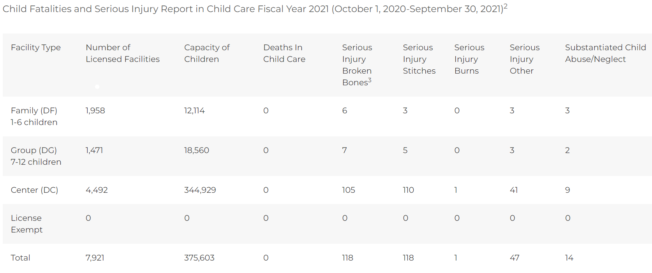
Safety Data
Unsafe safety practices may lead to children experiencing serious injuries.
Take a few minutes to review the included graph that details serious injury reports made to LARA during FY2021.

Slide 12
NMCAA Safety Data
R 400.8143: Children’s Records
On two separate occasions, consultants (supervised volunteers) nearly took children out of the classroom in an unsupervised capacity. Neither consultant was listed on the children’s information record nor approved for unsupervised release by their parents.
R 400.8152: Medication
During the inspection, a bottle of children's Benadryl was found for a 4-year-old which stated that it could not be given to a child between the ages of 2 and 5 years old without a doctor's authorization. There was not a doctor's authorization for this medication on site.
R 400.8161: Emergency Procedures
Staff were unable to locate the center’s crisis management plans.
R 400.8350: Toilets/Handwashing Sinks
The water temperature of the three sinks accessible to children in the women's bathroom were recorded at 120.6, 120.7, and 120.6.
*** REPEAT VIOLATION *** During the inspection, the water temperature in the men's restroom was recorded at 125.1- and 124.9-degrees F. Water temperature in the women's bathroom was recorded at 128.5- and 127.9-degrees F.
R 400.8380: Maintenance of Premises
Two large bottles of dish soap and several smaller bottles of hand soap were accessible to children in a cabinet under the handwashing sink in the classroom.
A cabinet within the children’s reach was unlocked and contained a variety of cleaning chemicals, creating a safety hazard.
Saran Wrap/Aluminum foil (which have sharp edges) were accessible to children.
R 400.8385: Toxic Materials
A spray bottle containing a flame-retardant chemical was accessible to children in the cupboard adjacent to the classroom door.
Included are some examples of safety violations that NMCAA programs have encountered in recent years:

Slide 13
Safety Practices Training
The remainder of this PowerPoint is divided up into four distinct areas of safety training:
Active Supervision
Pedestrian & Transportation Safety
Safe Environment Checklist & Required Postings
Safety & Emergency Preparedness/Grab & Go Binder
You must complete each safety section to receive credit for the whole training.
This training must be completed in its entirety prior to working in the classroom with children.

Slide 14
Active supervision
It’s time to learn about the six Active Supervision strategies, the importance of implementing these strategies, and explore some helpful resources to use in your learning environment.

Slide 15
Active Supervision Objectives & Goals
Articulate the definition and importance of Active Supervision.
Describe the six different Active Supervision strategies.
Identify strategies you can use in your learning environment.
Become familiar with the Active Supervision Plan contents.
Provide additional resources for future reference and use.

Slide 16
Active Supervision: Digging Deeper
Active Supervision is a term used regularly: In your learning environment(s), with your team, and by your supervisor.
Let’s dig a little deeper and explore the importance of implementing Active Supervision in your learning environment.

Slide 17
The 5 W’s & 1 H of Active Supervision
On the following slides, we will examine the 5 W’s and 1 H of Active Supervision:
WHO
WHAT
WHERE
WHEN
WHY
HOW

Slide 18
Active Supervision: The Who
Who is responsible for implementing Active Supervision?
EVERYONE!!
ALL early childhood staff are responsible for ensuring the safety of ALL children in their care.
This includes subs, visitors and volunteers. Be sure to inform and educate these individuals about Active Supervision: the six strategies, the location of your classroom’s plan, etc.

Slide 19
Active Supervision: The What
It’s focused attention and intentional observation.
Staff diligently watching and observing ALL children.
Being an active participant rather than passive.
Using prior knowledge about each child’s development, abilities, and needs.
The use of specific and intentional strategies to ensure that the children in our care are safe and always accounted for.

Slide 20
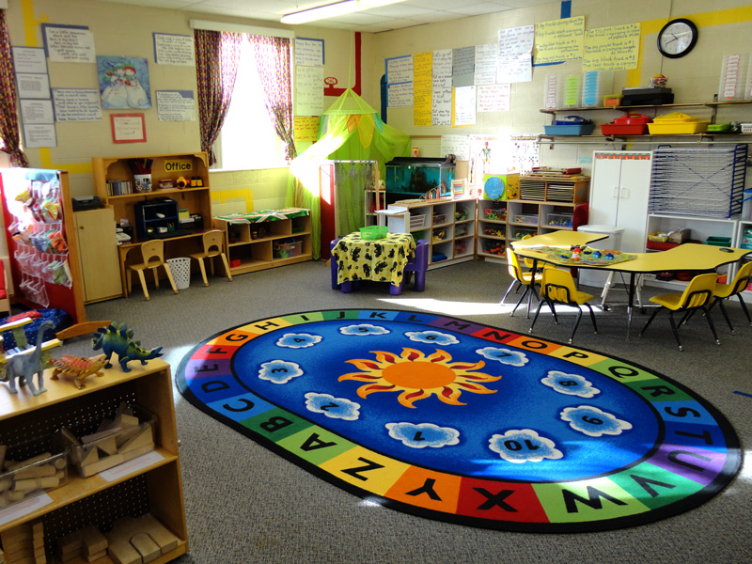
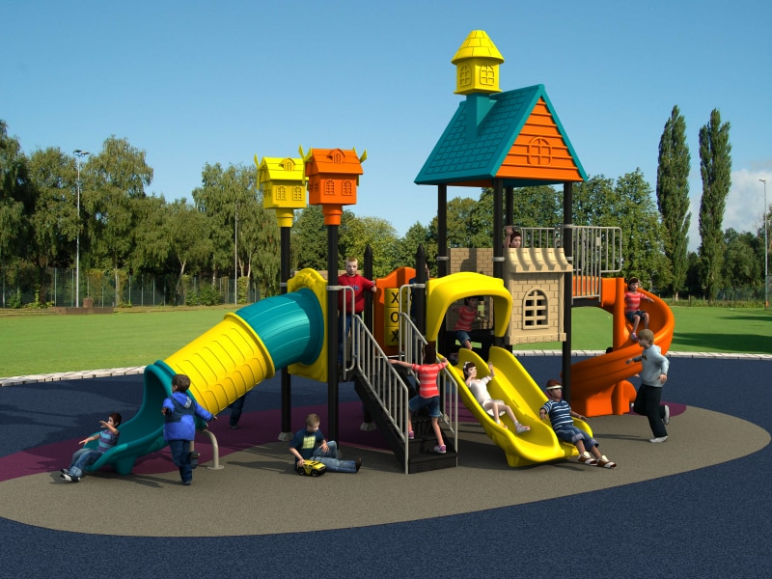
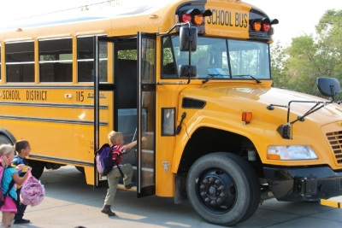
Active Supervision: The Where
Staff must employ Active Supervision strategies wherever children are while in their care:
Indoor learning environment(s)
On the playground
On the bus (as applicable)

Slide 21
Active Supervision: The When
Active supervision must happen during ALL parts of the daily routine. This includes….
Quiet time
Mealtimes
Diapering and bathroom use
Active supervision requires focused attention and intentional observation of children at ALL times.

Slide 22
Active Supervision: Our Why
Children’s safety is our top priority!
It’s a Head Start Program Performance Standards’ requirement:
1302.90 (c)(v) “Ensure no child is left alone or unsupervised by staff, consultants, contractors, or volunteers while under their care.”
It’s a Child Care Licensing requirement:
R 400.8125 (1) “All staff and volunteers shall provide appropriate care and supervision of children at all times.”
A lapse in active supervision will result in a special investigation by Licensing and possibly other authorities.
To learn more about Special Investigations, CLICK HERE for additional training.
It promotes safety and helps to prevent injuries.
Safe environments = opportunities for children to actively engage! ☺

Slide 23
Active Supervision: The How
How do we ensure that Active Supervision is implemented consistently and effectively?
By creating an Active Supervision Plan as a team.
Regularly reviewing and updating the Active Supervision Plan as needed.
Sharing the Active Supervision Plan with all team members, including new staff and substitutes.
By having open communication with all team members, both informally and formally: At Start Up and throughout the year, including at the end of the day, on Fridays, and at planned team meetings.
Attending and participating in ongoing trainings regarding Active Supervision.

Slide 24
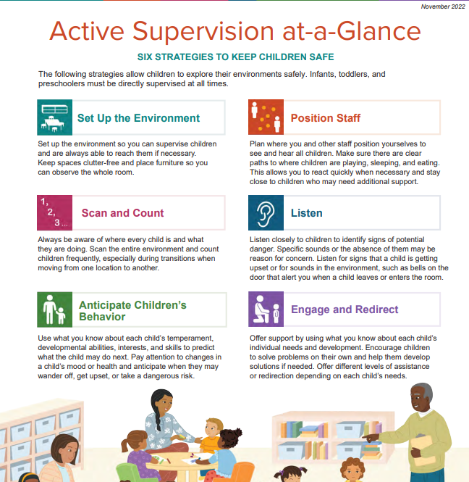
Active Supervision: The Six Strategies
There are six strategies that are crucial to effectively implementing Active Supervision:
Set Up the Environment
Position Staff
Scan and Count
Listen
Anticipate Children's Behavior
Engage and Redirect
Let’s take some time to examine each of these more closely.

Slide 25
Active Supervision: An Overview
Please watch this short video outlining the six Active Supervision Strategies.

Slide 26
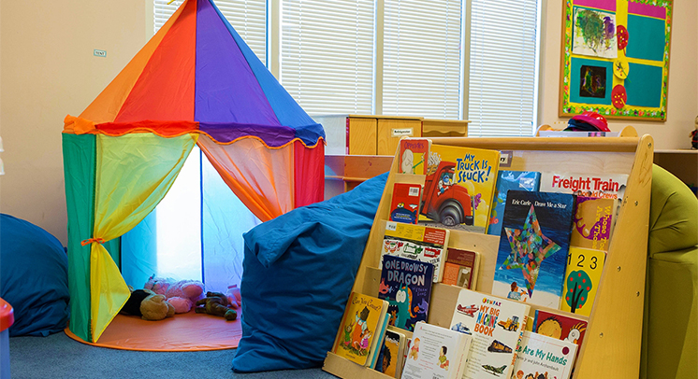
SETTING UP THE ENVIRONMENT

Slide 27
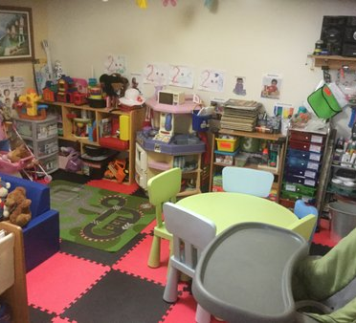
YAY or NAY?
Would Active Supervision be easily implemented in this learning environment? What do you think?
YAY
NAY

Slide 28
THAT’S RIGHT!
CLICK HERE TO LEARN MORE!

Slide 29
THAT’S INCORRECT!
CLICK HERE TO LEARN MORE!

Slide 30
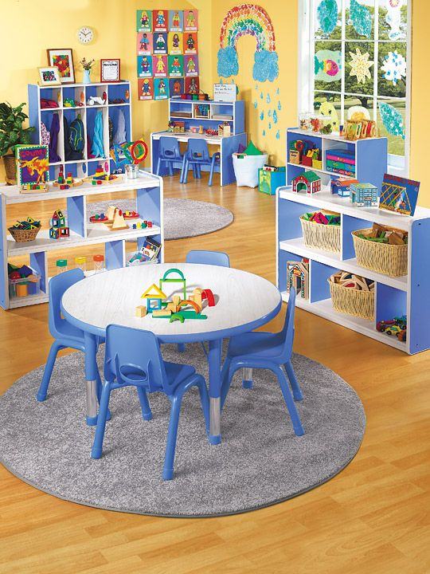
Setting Up the Environment: Key Points
There should be easy access to all areas.
Make sure you can easily move from one area to another.
Easy access doesn’t mean creating runways!
It’s important to have defined areas, but are there barriers in your way?
Keep furniture at waist height or lower to easily view children throughout the room.
Keep higher furniture against the wall.
Get down on your knees to have a “child’s view” of the classroom. Can you see all areas?
Provide clutter-free small spaces.
Too much clutter can provide for unsafe opportunities: reduced visibility, children tripping over materials, etc.
Provide open spaces for active play.
Active play areas, such as the block and house areas, require lots of space for children to actively engage.

Slide 31
POSITION STAFF
Please watch this informative video regarding the importance of positioning staff during Active Supervision.

Slide 32
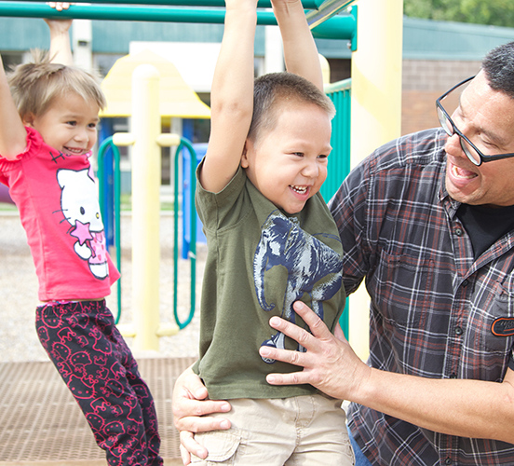
Position Staff: Key Points
It’s intentional placement of all staff.
Are all areas of the learning environment covered? Staff should be strategically placed to support children throughout all learning environments.
Placement should allow all staff to see and hear.
Staff should have a “global view” of the environment. Can you see and hear all children? This includes children not in your immediate space or vicinity.
Again, be sure that there are clear pathways that allow you to move easily from one area to another. You don’t want to be positioned in a “blocked in” area.
Stay close to those who need additional support.
This is a proactive strategy. As you become more aware of children’s personalities and temperaments, you will know which children may need that extra support, including you staying close to help ward off any incidents.

Slide 33
Listen: Key Points
Be aware of specific sounds…or absence thereof!
Listen for disturbances, crying or outbursts, anything that might indicate that something is awry!
This includes lack of sound: Did two children go into a bathroom, and minutes later it’s eerily quiet? This warrants some investigation!
Always listen for sounds of potential danger.
Doors opening, furniture moving, and so forth.
It’s important to implement additional strategies to support your listening skills.
Bells on doorknobs, a doorbell, any additional sounds to alert you.

Slide 34
SCAN and COUNT
Please watch this informative video regarding the importance of scan and count in Active Supervision.

Slide 35
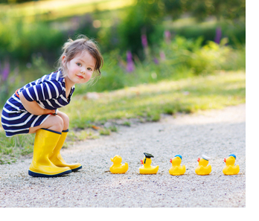
Scan and Count: Key Points
It’s our job to ensure that all children are accounted for.
Staff should continuously scan the environment; this incudes the WHOLE environment, not just the space you are in at the moment.
Counting children frequently is key.
It’s important to know how many children are present on a given day.
Staff need to communicate, communicate, communicate as to this changing number.
Scan and count is especially important during transitions!

Slide 36
TRANSITIONS
Active supervision is particularly important during times of transition:
Drop off and pick up
Moving from one activity to another
Changes in staffing patterns or children’s routines
Let’s watch this short video on the importance of active supervision during transitions.

Slide 37
Anticipate Children’s Behavior: Key Points
Know your children and plan accordingly.
Learn their temperaments, personalities, likes, dislikes, and tendencies.
Create challenges to help all children be successful.
How can you safely support children who are risk takers?
Be aware of those who wander, get upset, or take other risks.
Being aware is being proactive!
Read children’s cues: tired, ill, changes at home.
Could these things affect children’s behavior? Another way to be proactive!
Being proactive is key!! ☺

Slide 38
Engage and Redirect: Key Points
Be prepared to offer children individualized support.
All children are unique with different needs.
Remember…what works one day may not work the next; have lots of tools in your toolbox!
Encourage children to problem solve.
Adults are often quick to jump in and solve problems. Instead, consider supporting children with solving their own problems with “How else could we”-type questions.
Be prepared to offer varying levels of assistance or redirection based on each child.

Slide 39
Active Supervision Strategies & Ideas

Slide 40
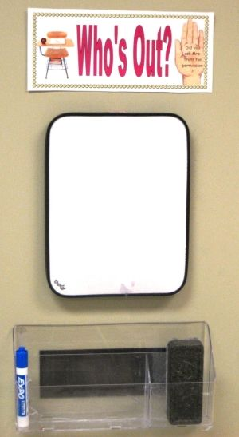
Strategies in the Classroom
Many classrooms use a whiteboard to document the number of children in attendance each day.
Be sure to keep in mind the following:
How do you communicate your “number” for the day?
How do you communicate when there are changes: another child arrives or leaves for the day?
How do you document or communicate when there are variances: A child leaves for speech, to use a bathroom outside the classroom, etc.?
Check in with your team on these important considerations!

Slide 41
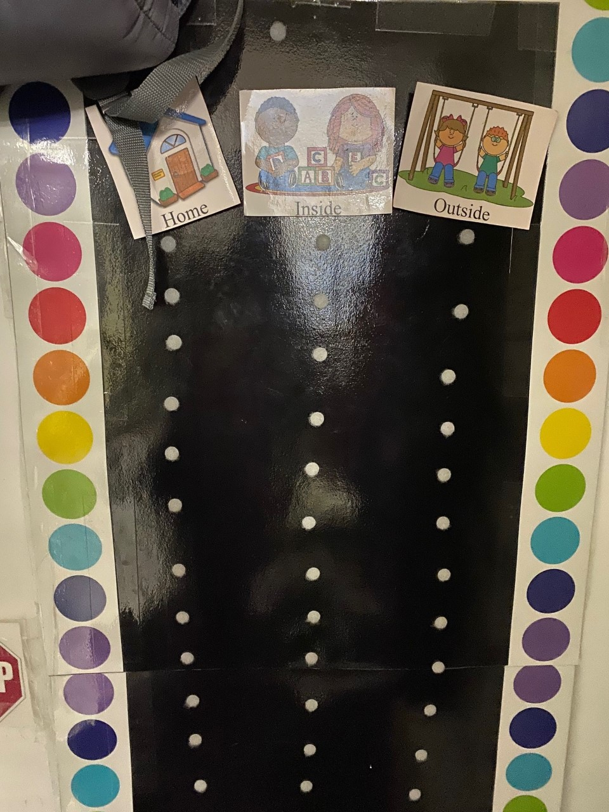
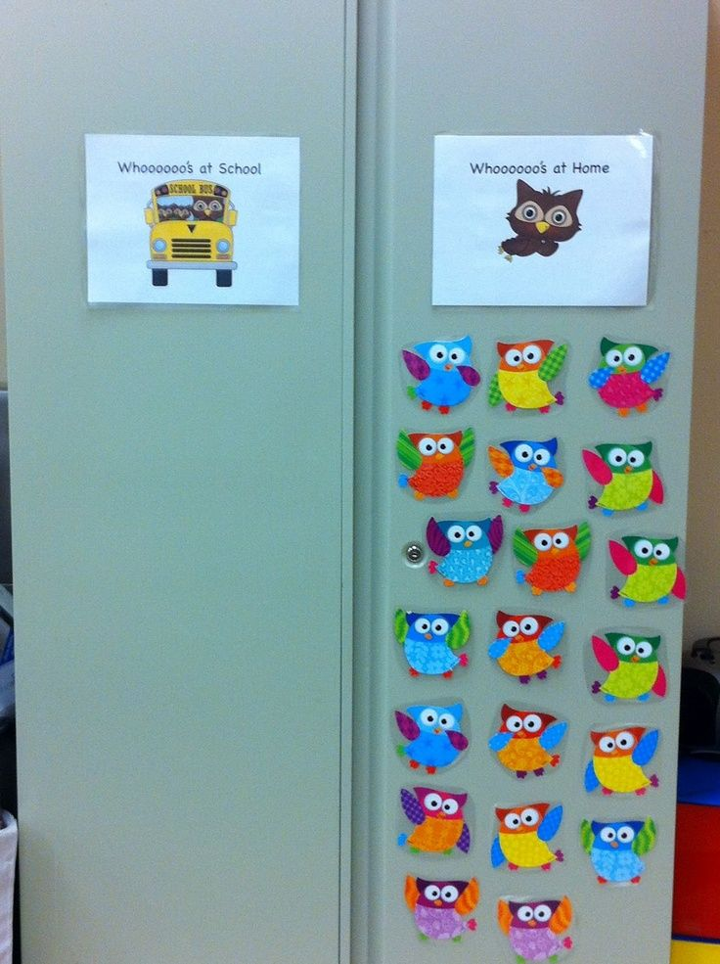
Ideas You Can Use
Consider an attendance chart where children can check in for the day.
Include children’s pictures with their names.
This offers a quick visual for who’s at school and who’s not.
What a great cross-reference for your whiteboard number.
Consider adding a column for “outside the room” reasons: bathroom, speech, etc.

Slide 42
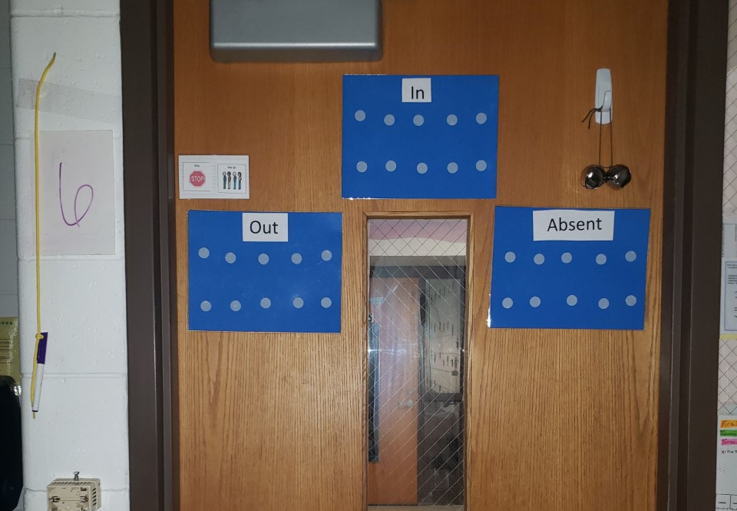
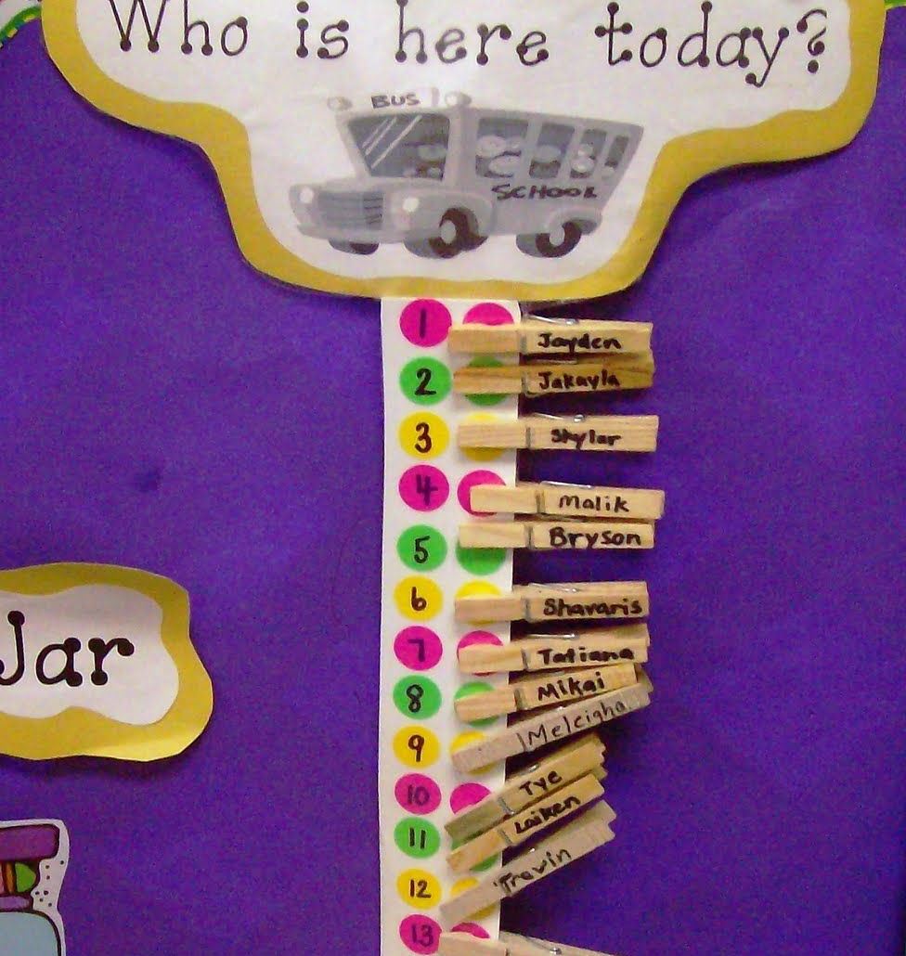
More Ideas!
Here is another option for attendance or keeping track of who is in or out of the room.
Check out the dots and how those could correspond with your whiteboard number!

Slide 43
Name-to-Face Recognition
What is Name-to-Face recognition?
It’s more than just roll call and counting.
It’s being acutely aware of the children you are responsible for, knowing them by name, and their personalities.
It provides a visual in your head to connect faces and names to those you are responsible for. It’s a means of reinforcement, which is especially important during transitions.
Use of concrete names and pictures are useful tools early in the year and are especially helpful for substitutes.

Slide 44
Active Supervision & Families
Communicating regularly with families is key to developing nurturing relationships with children.
Ongoing communication with families, including checking in daily with each family, can help you plan for supervision.
Families can help you learn about their child’s interests, abilities, and needs, which helps you anticipate when to engage and redirect the children in your care.
Strong relationships with families helps you tailor your approaches and create partnerships that ensure children are safe at home and in your classroom.

Slide 45
Family Resources
Collaborating with families on Active Supervision occurs all throughout the year:
Sharing information at Orientation along with the Parent/Guardian Handbook.
Providing additional information and resources at Parent-Teacher Conferences, Home Visits, and in newsletters.
What other ways could you sharing Active Supervision with your families?
Resources:
Below are some helpful resources as it relates to Active Supervision and collaborating with families.
“Injury Prevention Starts at Home”
“Safety and Injury Prevention: Tips for Families”
“A Guide to Safety Conversations with Families”
Be sure to connect with your FES, supervisor, or coach for ideas and resources related to this important topic!

Slide 46
Active Supervision & Staff Wellness
Early Childhood Education is demanding work!
Some days life throws you curveballs:
You may experience staffing changes;
You are pulled in a variety of directions dealing with challenging behaviors;
Or any other number of things that can happen on a given day!
Active Supervision NEVER takes a day, hour, or minute off!!
What are you doing to take care of YOU to stay on top of your Active Supervision game?

Slide 47
Staff Wellness
Please watch this short video on the importance of mindfulness and staff wellness.

Slide 48
Staff Wellness Resources
NMCAA offers a variety of resources to support staff on their wellness journey.
Employee Assistance Program
Wellness Coach
Starling Minds
NONI
ECLKC also provides a variety of resources to explore.

Slide 49
Active Supervision: Next Steps
Now that you’ve had time to become more familiar with Active Supervision, it’s time to examine how to intentionally plan and implement the Active Supervision strategies .
Please refer to the following slides for more information regarding Active Supervision postings and forms.

Slide 50
Active Supervision Postings
Active Supervision Poster
This poster must be displayed in an easily viewed location.
Where can you find a copy of this poster? Check here:
NMCAA HS Weebly
ECLKC

Slide 51
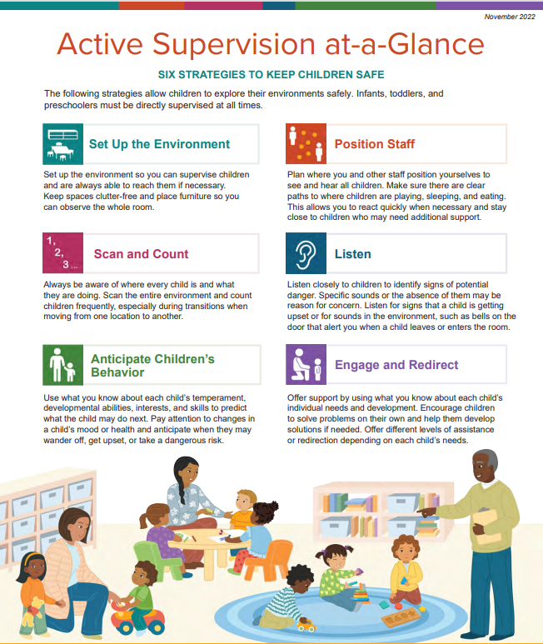
Active Supervision Postings
Active Supervision at-a-Glance
This optional posting provides a quick reference for the six Active Supervision strategies.
Where can you find a copy of this poster? Check here:
NMCAA HS Weebly
ECLKC

Slide 52
The next several slides provide an overview of the Active Supervision Plan contents.
Components of the Active Supervision Plan include the following:
Zoning to Maximize Learning: Discussion Questions
Zoning to Maximize Learning: Staff Zoning Chart
Active Supervision Implementation Plan
Classroom Maps: Indoor & Outdoor Spaces
Classroom Transitions: Planning for Transitions
A copy of the Active Supervision Plan is kept in the Green Grab & Go Binder.
Please contact your supervisor or lead teacher for a copy of your classroom’s completed Active Supervision Plan to reference.

Slide 53
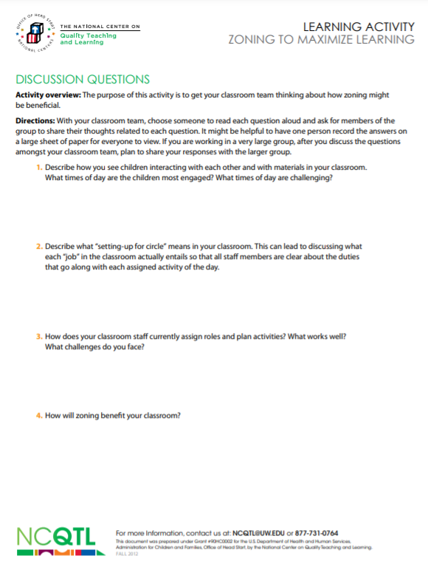
Zoning Discussion Questions
These questions are used to create a dialogue with your team regarding the creation of zones in your learning environment.
Remember, circumstances change over time. These questions can be revisited as needed. Flexibility is key!

Slide 54
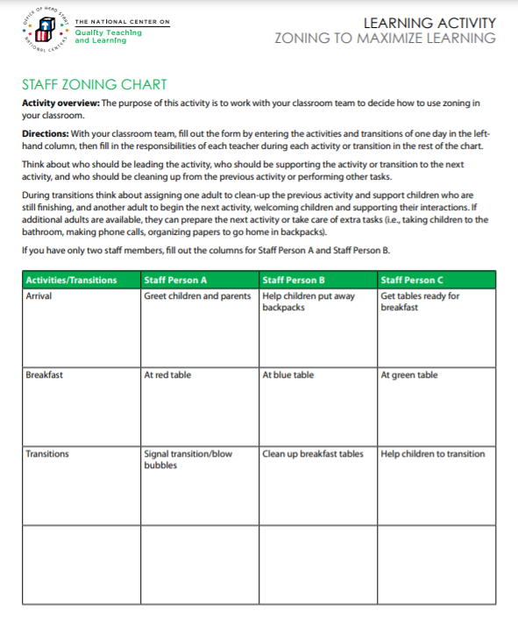
Staff Zoning Chart
Creating a zoning chart is an intentional practice to encourage children’s learning and keep them safe!
Your daily schedule is used for reference. It’s important to think about what each staff person will be doing during each part of the daily routine. Pay close attention to transitions. Your plan should be documented on the Staff Zoning Chart form.

Slide 55
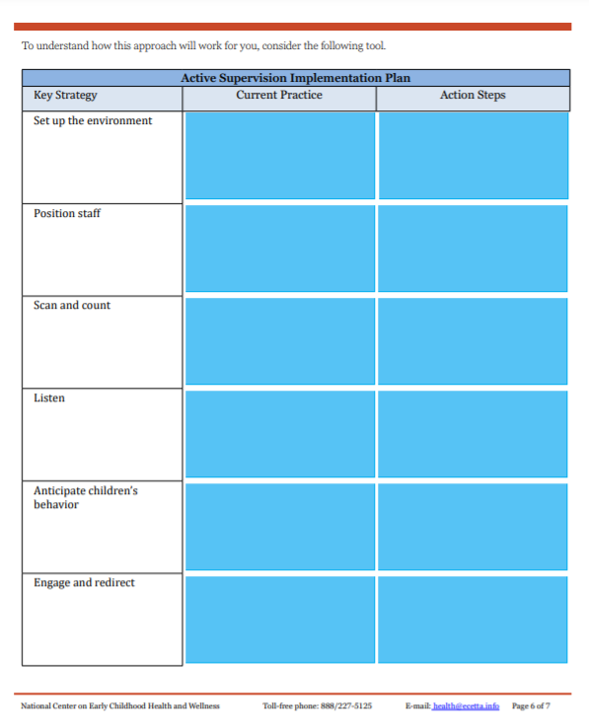
Implementation Plan
This form is used to reflect on the six Active Supervision strategies and the practices that have been used in the past.
What went well? Were there challenges? What changes might need to be implemented?
Points and ideas are noted on the Active Supervision Implementation Plan form.

Slide 56
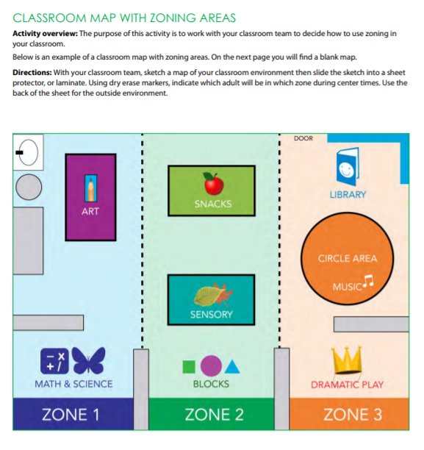
Classroom Map
A zoning map is completed for both the indoor and outdoor spaces.
Refer to the example included on this slide.
Maps that are already created for Licensing work for this, too!
Tip: Placing the map(s) in a sheet protector and assigning zones with a dry erase marker allows for quick and easy changes!

Slide 57
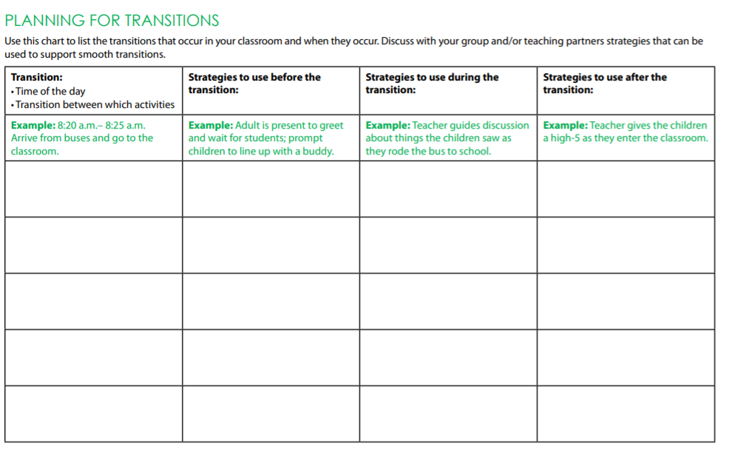
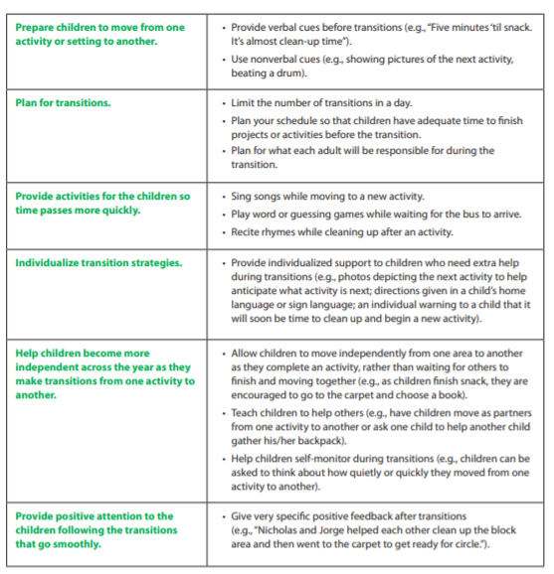
Planning for Transitions
Review the transition tip sheet included on this slide. This is a helpful reference when completing the Planning for Transitions form.
Your daily schedule is handy to have as you think about and plan for the variety of transitions throughout the day.
Who will be where?
What strategies and activities will you use?
How will you individualize your transition activities?
How will you promote independence in all children?

Slide 58
Active Supervision: Additional Resources
Here are some additional helpful resources to refer to while completing an Active Supervision plan:
Active Supervision Toolkit
Tips for Teachers: Classroom Transitions
Tips for Teachers: Zoning to Maximize Learning
Tips for Teachers: Designing Environments
Tools for Supervisors: Supporting Positive Behaviors During Classroom Transitions
NMCAA Head Start Weebly Site
ECLKC

Slide 59
Active Supervision: Final Thoughts
We are ALL responsible for the health and safety of ALL children while they are in our care.
Active supervision is a critical piece to ensuring that ALL children have opportunity to explore and learn in a caring, responsive, and safe environment!
Creating an Active Supervision Plan is an intentional process that should include everyone on the team.
A completed copy of your Active Supervision Plan is in your green Grab & Go binder.
Reminder: As the year goes along, changes are sure to happen! Pull out your Active Supervision Plan to review and make adjustments, as needed.
Up Next:
Pedestrian and Transportation Safety

Slide 60
PEDESTRIAN & TRANSPORTATION SAFETY
Next, let’s explore facts and resources related to pedestrian and transportation safety.

Slide 61
Why Pedestrian Safety?
Pedestrian safety is an important topic! We want to help make sure that all the children and families in our programs stay safe.
It’s also a part of the Head Start Program Performance Standards!
1302.46 Family support services for health, nutrition, and mental health.
(b) Opportunities. (1) Such collaboration must include opportunities for parents to:
(v) Learn about appropriate vehicle and pedestrian safety for keeping children safe.
Let’s explore some more pedestrian safety information and learn what our roles are related to supporting children and families with this important safety topic!

Slide 62
Pedestrian Accident Facts
81
81: A pedestrian was killed, on average, every 81 minutes in traffic crashes in 2020.
Other statistics from 2020 include the following:
A pedestrian was injured every 10 minutes.
Pedestrian-related traffic crashes caused 6,516 deaths.
54,769 pedestrians were injured.
16% of the children 14 years and younger who were killed in traffic crashes were pedestrians.

Slide 63
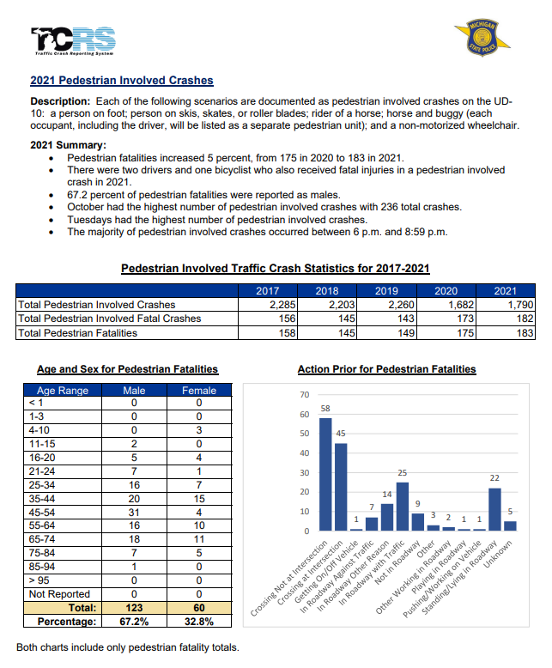
Michigan Facts
Here is data specific to the State of Michigan.
For more information, check out www.michigan.gov/ohsp

Slide 64
Pedestrian Safety & Young Children
Growth and Development Key Points
Children need to be able to choose the safest places to walk.
Children need to learn where to cross streets and how to cross safely.
Children will demonstrate these skills some of the time, so continued practice is needed.
Attention and concentration skills are essential for safe walking and develop as children mature.
Children: 4 to 6 years old
Need supervision
Are ready to practice the basics
May do the unexpected
Need adults to model safe walking behavior

Slide 65
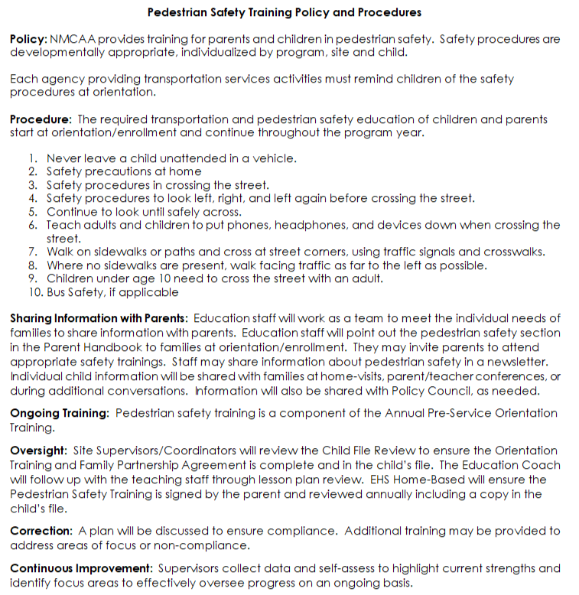
NMCAA Pedestrian Safety Training Policy & Procedures
Please review the most up-to-date version of NMCAA’s Pedestrian Safety Training Policy & Procedures.

Slide 66
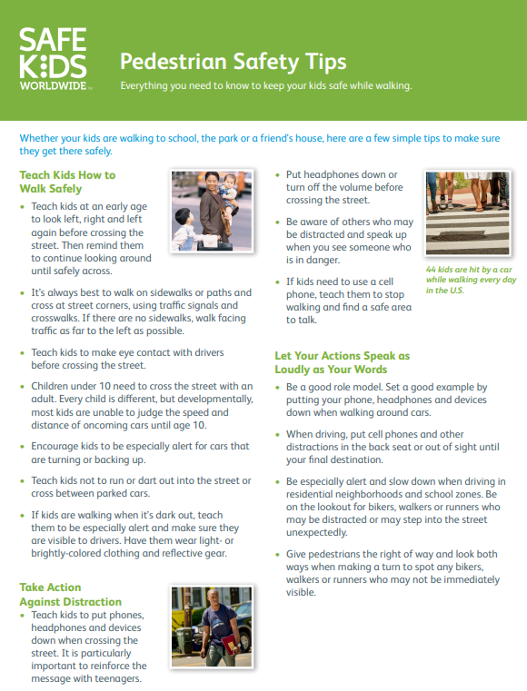
Pedestrian Safety Training Process
Pedestrian safety occurs all throughout the year with children and families:
Sharing information at Orientation along with the Parent Handbook.
Providing additional information and resources during Parent-Teacher Conferences, Home Visits, and in newsletters.
This tip sheet will be shared with families at the first home visit. Look to your education coach for more guidance on this.
Intentionally planning activities and putting out materials to support children’s knowledge on this topic.
Be sure to connect with your education coach for ideas and resources related to this important topic!

Slide 67
Transportation Safety
Transportation safety is dictated by both Head Start and Licensing regulations:
Head Start
1303.74 Safety procedures.
(a) A program must ensure children who receive transportation services are taught safe riding practices, safety procedures for boarding and leaving the vehicle and for crossing the street to and from the vehicle at stops, recognition of the danger zones around the vehicle, and emergency evacuation procedures, including participating in an emergency evacuation drill conducted on the vehicle the child will be riding.
(b) A program that provides transportation services must ensure at least two bus evacuation drills in addition to the one required under paragraph (a) of this section are conducted during the program year.
Licensing
R 400.8710 Transportation.
R 400.8720 All motor vehicles.
R 400.8730 Safety equipment in motor vehicles.
R 400.8740 Manufacturer’s rated seating capacity; restraint devices; safety belts.
R 400.8750 Motor vehicle operator.
R 400.8760 Staff and volunteer-to-child ratio and supervision in transit.
R 400.8770 Time limitation on child transit.

Slide 68
Transportation Safety & Active Supervision
Just as in different learning environments, Active Supervision is an integral part of keeping children safe as they are being transported to and from school.
Active Supervision is EVERYONE’S responsibility!
We are all tasked with ensuring children’s safety.
Active Supervision is not just for those who ride Transit or Agency buses.
It’s important to work with parents and local school districts to promote transportation safety to and from school.

Slide 69
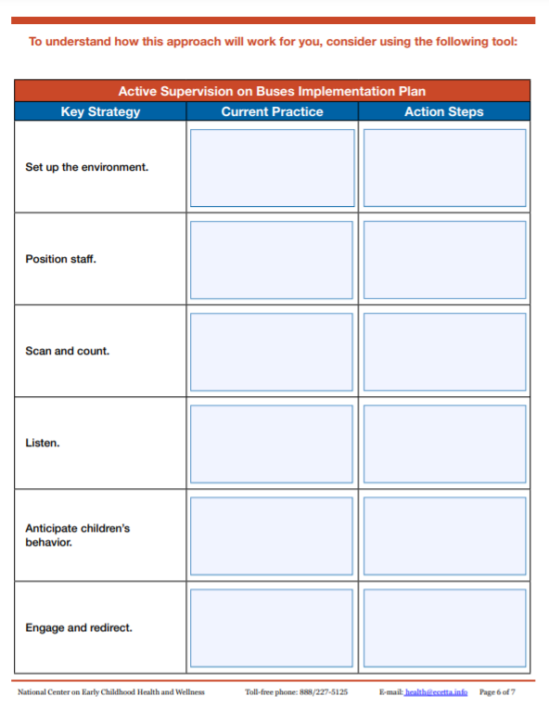
Active Supervision Planning
Look!
Take a look at this form on the right.
Look familiar?
That’s right! Creating an intentional plan for Active Supervision on the bus is just as important as the plans you make for your indoor and outdoor learning environments!
It’s important!
Even if children ride district buses, these six strategies still apply.

Slide 70
Transportation Safety Education
In addition to actively supervising children as they are transported to and from school, we must also be sure to help children learn safe riding practices, as well as safe ways to board and leave the bus.
Talk with children about being safe while they are on the bus. What are the expectations for being safe?
Engaging children throughout their daily routine with books and other activities related to bus safety.
Providing resources for families so everyone is on the same page regarding bus safety.

Slide 71
Transportation Policies & Procedures
NMCAA has other policies and procedures related to transportation services.
Please take time to review and become familiar with the documents included on the following slides.
Be sure to follow up with your supervisor regarding any questions or concerns you have on any of these documents or policies.
Transportation Types
Self-Transportation
NMCAA Bussing
Transit
Public School District

Slide 72
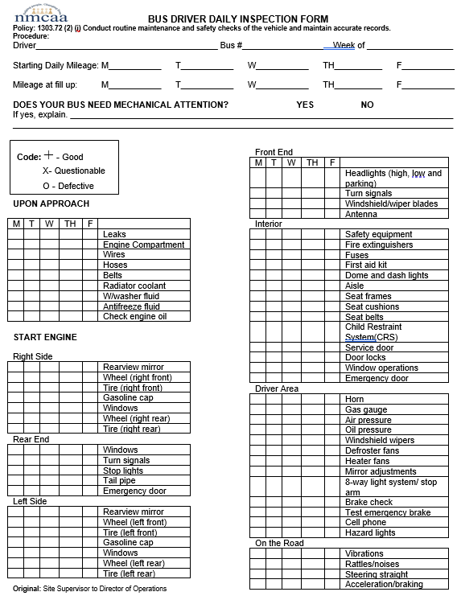
NMCAA Bussing
WHAT
Please take time to review the following form:
Bus Driver Daily Inspection Form
WHEN
REMEMBER!
This must be completed daily.
This must be sent to your site supervisor and Director of Operations.

Slide 73
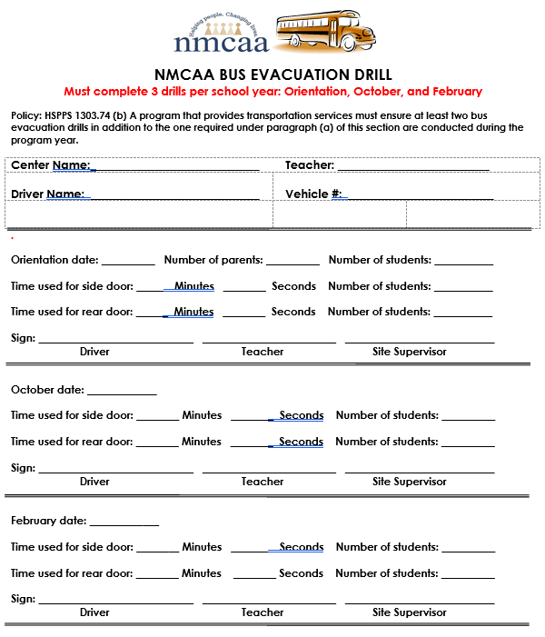
Required Forms to be Completed
Please take time to review the following document:
NMCAA Bus Evacuation Drill
REMEMBER
This must be completed 3 times/year for transit and NMCAA bussing.
This must be sent to your site supervisor and Director of Operations.
Keep the original copy on site.

Slide 74
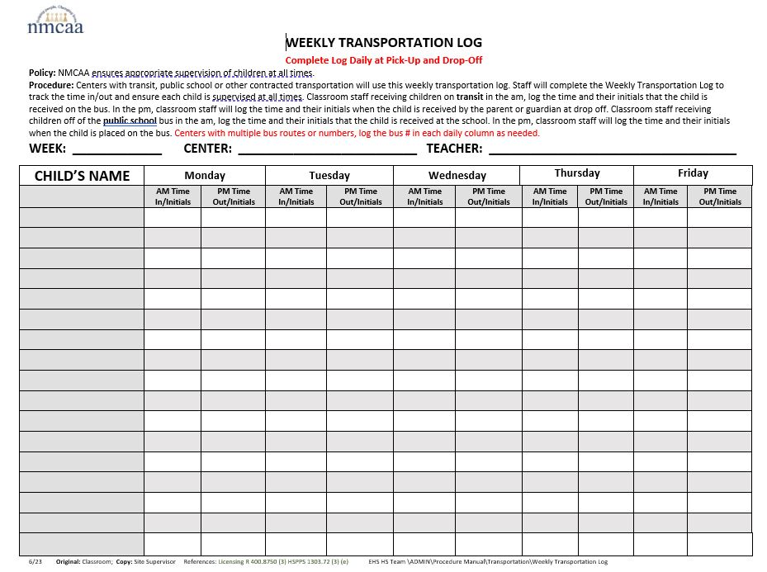
NMCAA Bussing, Transit, Public School District: Required Forms to be Completed
Please take time to review the following document:
REMEMBER: This must be sent to your site supervisor at the end of each month with the What’s Due When paperwork.
Weekly Transportation Log

Slide 75
ALL SITES
Please take time to review and become familiar with the following two documents:
Bus Procedures in Emergency Situations
Transportation Safety Procedures
REMEMBER
Classroom copies must be reviewed and signed.
These are posted at your site regardless of self-transportation.

Slide 76
Pedestrian & Transportation Safety: Final Thoughts
Remember: Teaching children about pedestrian and transportation safety is not only a requirement, but also another important piece to keeping children safe while in our care.
Be sure to check out all the additional pedestrian and transportation safety resources on Weebly and on the SharePoint PD page.
UP NEXT: Safe Environment Checklist

Slide 77
Safe environment checklist
Let’s take some time to explore NMCAA’s Safe Environment Checklist, its importance, and relevant updates and changes.

Slide 78
Safe Environments: Why Does it Matter?
Feeling safe and secure is important to all of us…even as adults!
Children depend on us to help keep them safe and out of harm’s way.
When children feel safe, they are more likely to build important, trusting relationships.
When children do not feel safe, this creates a barrier to active learning and children reaching their potential.
Understanding the importance of keeping all children safe, and what safe environments look like, are important steps to providing a space where children can grow, learn and thrive.

Slide 79
Safe Environment Checklist
The Safe Environment Checklist is a compilation of rules and regulations that align with the Office of Head Start and LARA’s safety standards.
Goals related to completion of the checklist include the following:
Staff are versed in safety rules and regulations.
Staff are aware of new requirements related to safety protocols.
Safety issues are addressed and rectified before and throughout the program year.
Staff are prepared for visits from their Licensing consultant.
Children are ensured safe environments in which they can actively engage.

Slide 80
Safe Environment Checklist Steps
Classroom staff must complete the SEC twice each program year.
Teams complete all applicable sections in the checklist.
Make notes of any findings and be sure to share them with your supervisor.
Be sure to look for what each indicator is asking and ensure that all required pieces are in place.

Slide 81
Safety & emergency preparedness plan and Grab & Go Binder
Now it’s time to explore NMCAA’s Safety & Emergency Preparedness Plan, Grab & Go Binder, their contents, and why they’re important!

Slide 82
Emergency Preparedness: Why Does it Matter?
Emergencies can happen in a blink of an eye. Emergency preparedness is the process of taking steps to ensure that all involved are safe before, during, and after an emergency.
There are three focus areas related to emergency management:
Preparedness: This takes place prior to an emergency. This involves being informed about any possible emergencies, creating plans to respond to emergencies, and collecting necessary supplies needed during emergencies.
Response: This begins the moment you become aware an emergency is imminent and continues as the emergency occurs.
Recovery: This begins as soon as the emergency is over. Recovery efforts tend to focus on such things as shelter, health and emotional needs, and food/water.
Early childhood staff play pivotal roles in supporting children during all three phases of emergency management.

Slide 83
Safety & Emergency Preparedness Plan
The Safety & Emergency Preparedness Plan was developed to support staff with unforeseen events and emergencies.
Goals related to this plan include the following:
Provide practical guidelines that enable staff to properly prepare and respond to a variety of emergency situations.
Enable all involved to protect the health and well-being of staff and clients.
Be prepared to secure the facilities and infrastructure.
Maintain/resume program operations when incidents occur.

Slide 84
Safety & Emergency Preparedness Plan Steps
The Safety & Emergency Preparedness Plan must be completed prior to the start of the program year. All team members who work in the building (EHS, R&H, FES, etc.) and building collaborators assist in completing the Safety & Emergency Preparedness Plan.
Each section is reviewed for emergency instructions and guidance.
Contact information and emergency protocols are documented throughout the plan.
Completed plans must be submitted to jmcnally@nmcaa.net and your supervisor.
Completed plans are housed in the documents section of our payroll system.
The plan is reviewed when the second Safe Environment Checklist is completed. Any changes are updated as they occur throughout the year.

Slide 85
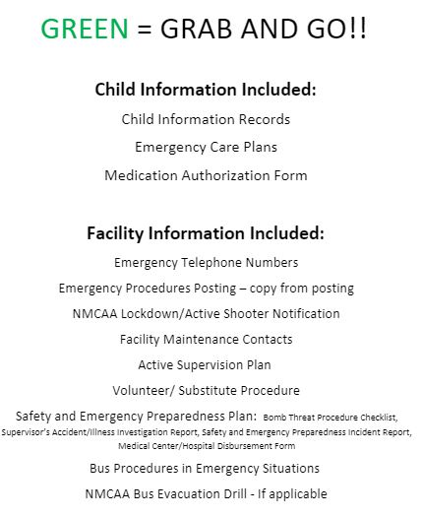
Grab & Go Binder
The Grab & Go Binder is intended to house important documents that are easily accessible to all staff.
It’s a “portable” filing system intended to be used “on-the-go.”
This could be in the classroom, on the playground, on a field trip, etc.
It’s important to ensure that the Grab & Go Binder is up-to-date with all the current completed forms, plans, and procedures.
Be sure to become familiar with and review the Grab & Go Binder’s required contents. Completed forms, plans, and procedures must be updated, as necessary.
Refer to Weebly or the SharePoint PD page for required forms and documents.

Slide 86
Remember…..
Review
Your classroom’s Active Supervision Plan
Review and Sign
Bus & Transportation Safety procedures documents
Review
A Safe Environment Checklist
Review
All required postings; be sure to sign or initial as needed
Review
Your Safety & Emergency Preparedness Plan and your classroom’s Grab & Go Binder.
Share
Completed plans and checklists are shared with your supervisor and all others noted throughout the training. Be sure to reach out with any questions or concerns.

Slide 87
Final Training Steps
Complete a Professional Development Participation Log (for attendance).
Please use the following training title:
Safety Practices Overview for New Staff
You will receive 2.5 training hours.
Please click on the following LINK to access the PD log or scan the included QR code.

Slide 88
References
“Active Supervision Presentation Produced.” YouTube, uploaded by Michelle Fitzsimmons, 19 April 2016, Active Supervision Presentation Produced – YouTube.
“Classroom Transitions.” YouTube, uploaded by usgovACF, 20 July 2015, https://www.youtube.com/watch?v=5SCCRIOEahs.
“Maintaining Accountabiilty.” Uploaded by Virtual Lab School, https://stream.virtuallabschool.org/safety/3074/3074-480.mp4.
“Mindfulness: A Resilience Practice.” ECLKC, uploaded by usgovACF, 4 May 2020, https://eclkc.ohs.acf.hhs.gov/video/mindfulness-resilience-practice.
“Preschool from a two year olds view point.” YouTube, uploaded by Katie Stauffer, 11 Aug. 2017, https://www.youtube.com/watch?v=jtnOCRBku7s2.
“Supervision: Positioning – Where Do I Stand?” YouTube, uploaded by Better Kid Care, 1 Sept. 2015, https://www.youtube.com/watch?v=Z8ewYm_DuEM.
“Supervision: What’s the Count?” YouTube, uploaded by Better Kid Care, 1 Sept. 2015, https://www.youtube.com/watch?v=_3Yhc9JT88s.
“Active Supervision Presentation Produced.” YouTube, uploaded by Michelle Fitzsimmons, 19 April 2016, Active Supervision Presentation Produced – YouTube.
“Supervision: Positioning – Where Do I Stand?” YouTube, uploaded by Better Kid Care, 1 Sept. 2015, https://www.youtube.com/watch?v=Z8ewYm_DuEM.

Slide 89
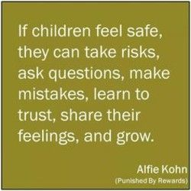
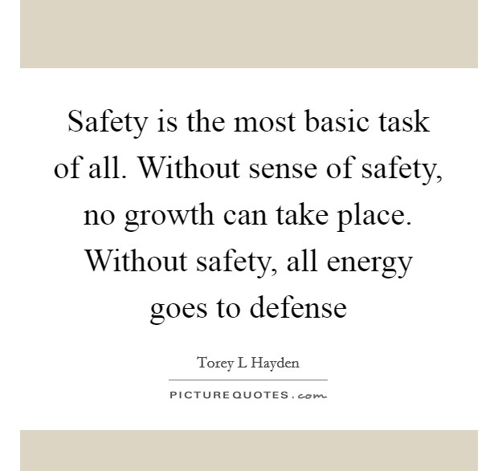
The End!
Thank you for your commitment to creating a safe space in which children can actively engage, grow, and develop!

