Slide 1
Active Supervision Overview for New Staff
Be sure to watch this as a Slide Show!

Slide 2
Welcome!
Welcome to this presentation on Active Supervision.
It’s important to remember that it’s EVERYONE’S responsibility to keep ALL children safe. Active Supervision is a crucial piece to ensuring children’s safety.
To receive credit for this training, please consider the following:
Complete the PowerPoint in its entirety, including watching all the included videos.
Click on the Professional Development Participation Log link or scan the QR code at the end of this presentation. This is proof of your attendance.
Please complete the Professional Development Survey, also included at the end of this presentation. This will give you opportunity to reflect on Active Supervision as well as time to provide ideas for additional professional development topics that may be beneficial to you!

Slide 3
Training Objectives
Articulate the definition and importance of Active Supervision.
Describe the six different Active Supervision strategies.
Identify strategies you can use in your learning environment.
Become familiar with Active Supervision Plan contents.
Provide additional resources for future reference and use.

Slide 4
“Active” Supervision? Or Not?
Please watch this short video. What are your noticings about the interactions and the supervision that is occurring (or not occurring) throughout the video?

Slide 5
Active Supervision & Child Safety
Active Supervision is an integral part to keeping children safe.
On the next slide, take some time to review safety citations reported to the Office of Head Start.

Slide 6
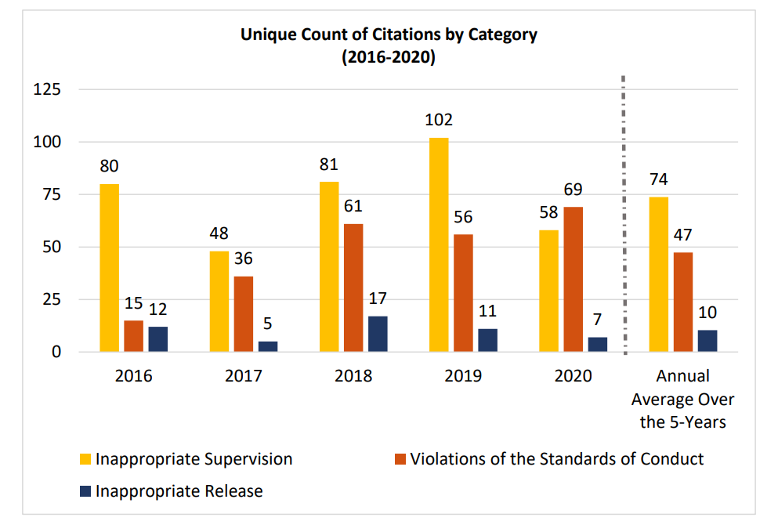
Child Safety Citations
The included graph represents child safety citations reported to the Office of Head Start between 2016 to 2020.
What trends do you see?

Slide 7
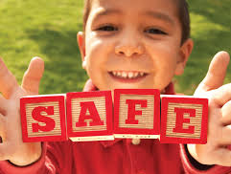
What Are You Doing?
Take a minute to reflect on strategies you use daily to keep ALL children safe.

Slide 8
Active Supervision: Digging Deeper
Let’s dig a little deeper and explore the importance of implementing Active Supervision in your learning environment.
Let’s take some time to explore the 5 W’s and 1 H of Active Supervision.

Slide 9
Active Supervision: The WHO
Who is responsible for implementing Active Supervision?
EVERYONE!!
ALL early childhood staff are responsible for ensuring the safety of ALL children in their care.
This includes subs, visitors and volunteers. Be sure to inform and educate these individuals about Active Supervision: the six strategies, the location of your classroom’s plan, etc.

Slide 10
Active Supervision: The WHAT
It’s focused attention and intentional observation.
Staff diligently watching and observing ALL children.
Being an active participant rather than passive.
Using prior knowledge about each child’s development, abilities, and needs.
The use of specific and intentional strategies to ensure that the children in our care are safe and always accounted for.

Slide 11
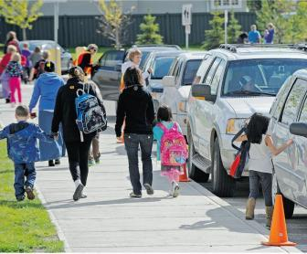
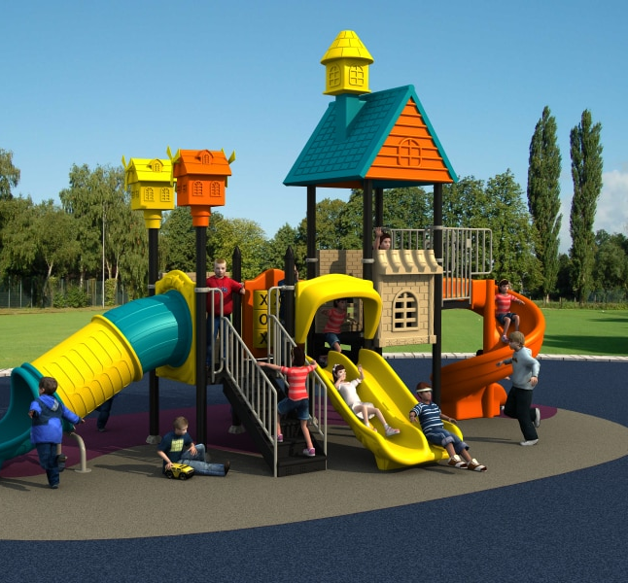
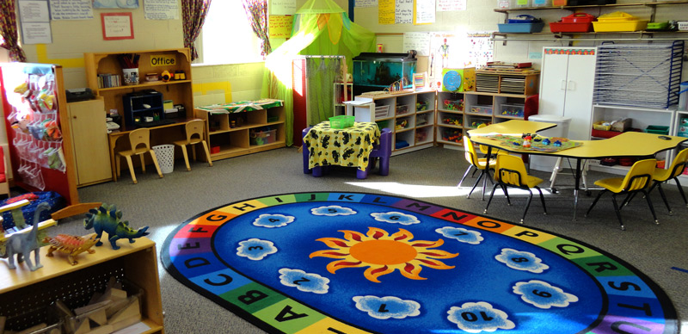
Active Supervision: The WHERE
Staff must employ Active Supervision strategies wherever children are while in their care:
Indoor learning environment(s)
On the playground
Transitioning to and from school

Slide 12
Active Supervision: The WHEN
Active supervision must happen during ALL parts of the daily routine. This includes….
Quiet time
Mealtimes
Diapering and bathroom use
Active supervision requires focused attention and intentional observation of children at ALL times.

Slide 13
Active Supervision: Our WHY
Children’s safety is our top priority!
It’s a Head Start Performance Standards’ requirement:
1302.90 (c)(v) “Ensure no child is left alone or unsupervised by staff, consultants, contractors, or volunteers while under their care.”
It’s a Child Care Licensing requirement:
R 400.8125 (1) “All staff and volunteers shall provide appropriate care and supervision of children at all times.”
A lapse in active supervision will result in a special investigation by Licensing and possibly other authorities.
It promotes safety and helps to prevent injuries.
Safe environments = opportunities for children to actively engage! ☺

Slide 14
Active Supervision: The HOW
How do we ensure that Active Supervision is implemented consistently and effectively?
By creating an Active Supervision Plan as a team.
Regularly reviewing and updating the Active Supervision Plan as needed.
Sharing the Active Supervision Plan with all team members, including new staff and substitutes.
By having open communication with all team members, both informally and formally: Before the program year starts and throughout the year, including at the end of the day, on Fridays, and at planned team meetings.
Attending and participating in ongoing trainings regarding Active Supervision.

Slide 15
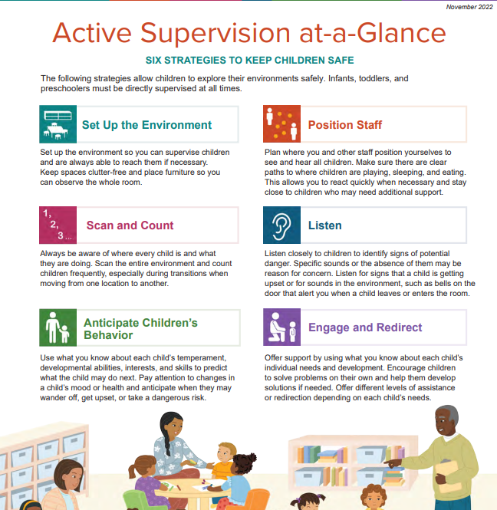
Active Supervision: The Six Strategies
There are six strategies that are crucial to effectively implementing Active Supervision:
Set Up the Environment
Position Staff
Scan and Count
Listen
Anticipate Children's Behavior
Engage and Redirect
Let’s take some time to examine each of these more closely.

Slide 16
Active Supervision: An Overview
Please watch this short video outlining the six Active Supervision strategies.

Slide 17
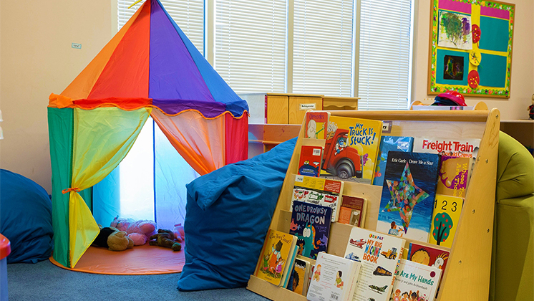
Setting Up the Environment

Slide 18
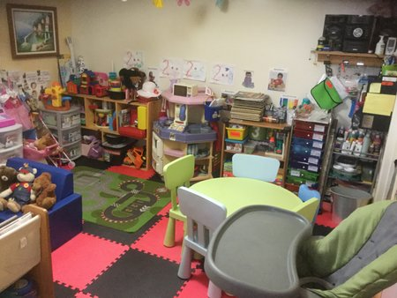
YAY or NAY?
Would Active Supervision be easily implemented in this learning environment? What do you think?
YAY
NAY

Slide 19
THAT’S RIGHT!
CLICK HERE TO LEARN MORE!

Slide 20
THAT’S INCORRECT!
CLICK HERE TO LEARN MORE

Slide 21
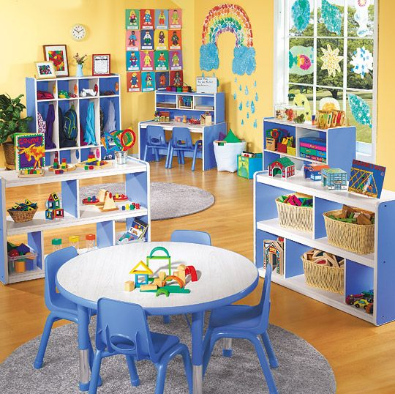
Setting up the Environment: Key Points
There should be easy access to all areas.
Make sure you can easily move from one area to another.
Easy access doesn’t mean creating runways!
It’s important to have defined areas, but are there barriers in your way?
Keep furniture at waist height or lower to easily view children throughout the room.
Keep higher furniture against the wall.
Get down on your knees to have a “child’s view” of the classroom. Can you see all areas?
Provide clutter-free small spaces.
Too much clutter can provide for unsafe opportunities: reduced visibility, children tripping over materials, etc.
Provide open spaces for active play.
Active play areas, such as the block and house areas, require lots of space for children to actively engage.

Slide 22
Position Staff
Please watch this informative video regarding the importance of positioning staff during Active Supervision.

Slide 23
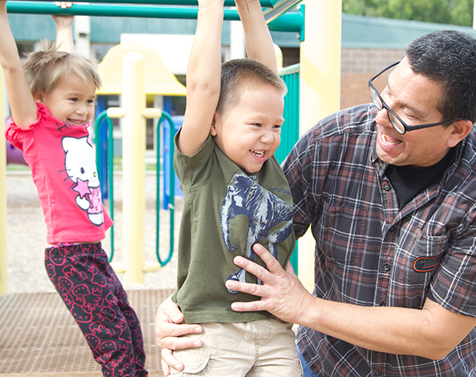
Position Staff: Key Points
It’s intentional placement of all staff.
Are all areas of the learning environment covered? Staff should be strategically placed to support children throughout all learning environments.
Placement should allow all staff to see and hear.
Staff should have a “global view” of the environment. Can you see and hear all children? This includes children not in your immediate space or vicinity.
Again, be sure that there are clear pathways that allow you to move easily from one area to another. You don’t want to be positioned in a “blocked in” area.
Stay close to those who need additional support.
This is a proactive strategy. As you better know children’s personalities and temperaments, you will know which children may need that extra support, including you staying close to help ward off any incidents.

Slide 24
Listen: Key Points
Be aware of specific sounds…or absence thereof!
Listen for disturbances, crying or outbursts, anything that might indicate that something is awry!
This includes lack of sound: Did two children go into a bathroom, and minutes later it’s eerily quiet? This warrants some investigation!
Always listen for sounds of potential danger.
Doors opening, furniture moving, and so forth.
It’s important to implement additional strategies to support your listening skills.
Bells on doorknobs, a doorbell, any additional sounds to alert you.

Slide 25
Scan and Count
Please watch this informative video regarding the importance of scan and count in Active Supervision.

Slide 26
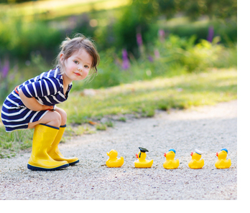
Scan and Count: Key Points
It’s our job to ensure that all children are accounted for.
Staff should continuously scan the environment; this incudes the WHOLE environment, not just the space you are in at the moment.
Counting children frequently is key.
It’s important to know how many children are present on a given day.
Staff need to communicate, communicate, communicate as to this changing number.
Scan and count is especially important during transitions!

Slide 27
Transitions
Active supervision is particularly important during times of transition:
Drop off and pick up
Moving from one activity to another
Changes in staffing patterns or children’s routines
Please watch this short video on the importance of active supervision during transitions.

Slide 28
Anticipate Children’s Behavior
Know your children and plan accordingly.
Learn their temperaments, personalities, likes, dislikes, and tendencies.
Create challenges to help all children be successful.
How can you safely support children who are risk takers?
Be aware of those who wander, get upset, or take other risks.
Being aware is being proactive!
Read children’s cues: tired, ill, changes at home.
Could these things affect children’s behavior? Another way to be proactive!
Being proactive is key!! ☺

Slide 29
Engage & Redirect: Key Points
Be prepared to offer children individualized support.
All children are unique with different needs.
Remember…what works one day may not work the next; have lots of tools in your toolbox!
Encourage children to problem solve.
Adults are often quick to jump in and solve problems. Instead, consider supporting children with solving their own problems with “How else could we”-type questions.
Be prepared to offer varying levels of assistance or redirection based on each child.

Slide 30
Active Supervision Strategies & Ideas

Slide 31
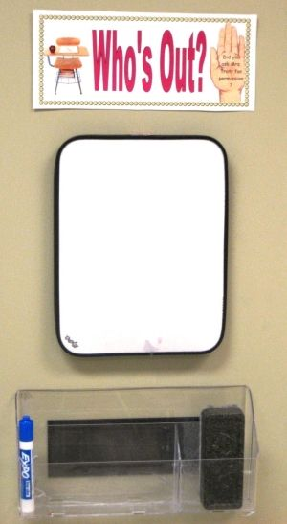
Strategies in the Classroom
Many classrooms use a whiteboard to document the number of children in attendance each day.
Be sure to keep in mind the following:
How do you communicate your “number” for the day?
How do you communicate when there are changes: another child arrives or leaves for the day?
How do you document or communicate when there are variances: A child leaves for speech, to use a bathroom outside the classroom, etc.?
Check in with your team on these important considerations!

Slide 32
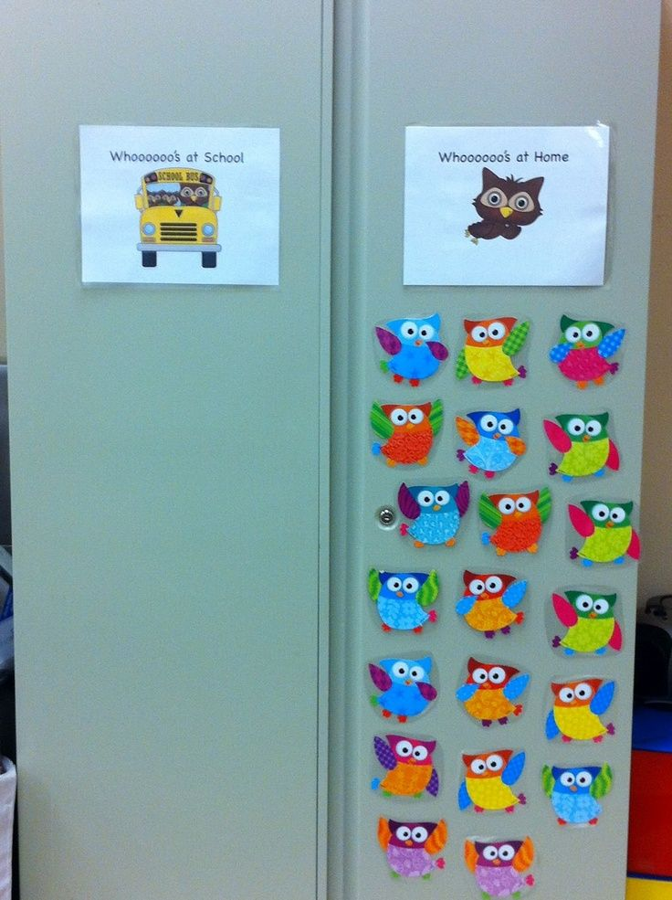
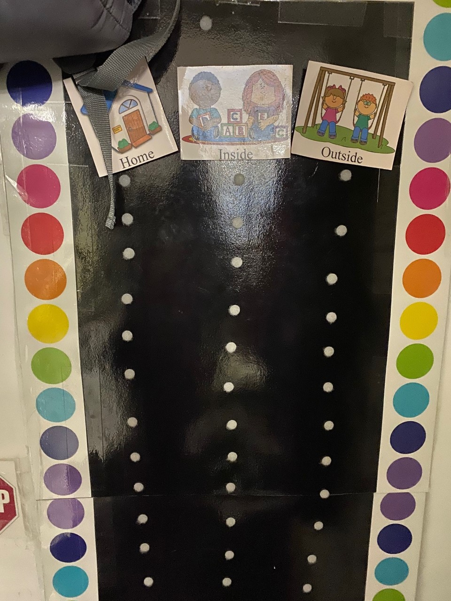
Ideas You Can Use
Consider an attendance chart where children can check in for the day.
Include children’s pictures with their names.
This offers a quick visual for who’s at school and who’s not.
What a great cross-reference for your whiteboard number.
Consider adding a column for “outside the room” reasons: bathroom, speech, etc.

Slide 33
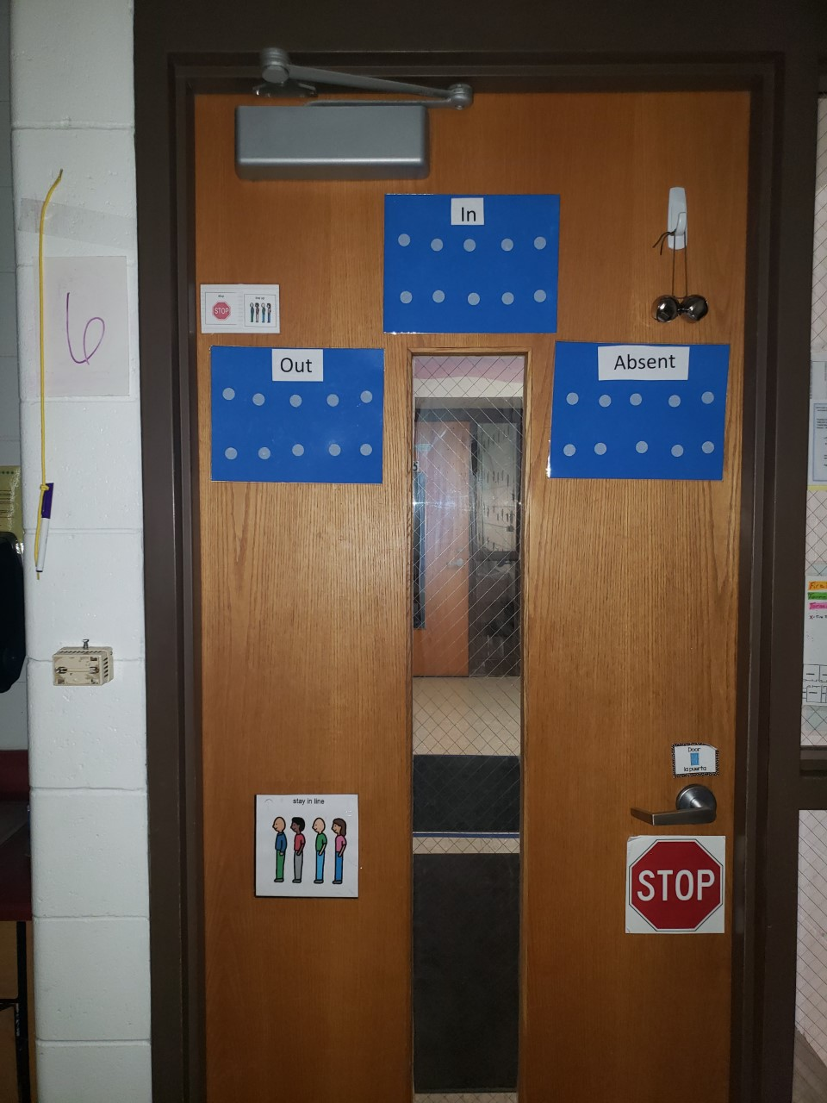
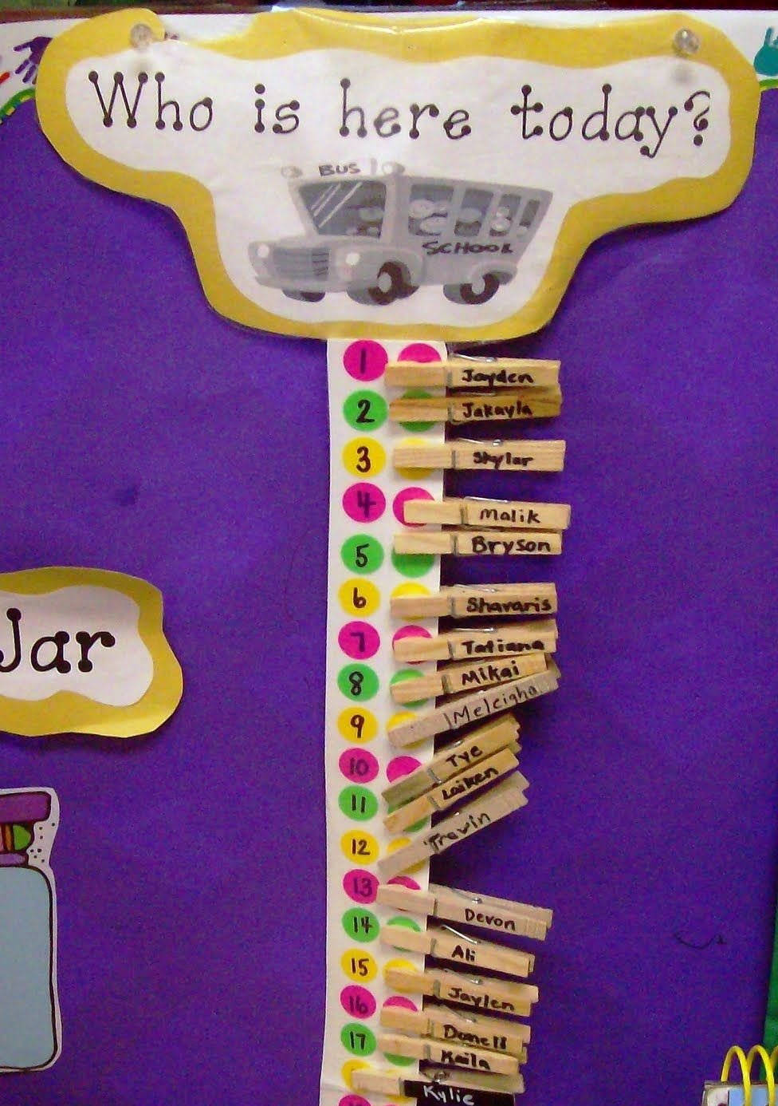
More Ideas!
Here is another option for attendance or keeping track of who is in or out of the room.
Check out the dots and how those could correspond with your whiteboard number!

Slide 34
Name-to-Face Recognition
What is Name-to-Face recognition?
It’s more than just roll call and counting.
It’s being acutely aware of the children you are responsible for, knowing them by name, and their personalities.
It provides a visual in your head to connect faces and names to those you are responsible for. It’s a means of reinforcement, which is especially important during transitions.
Use of concrete names and pictures are useful tools early in the year and are especially helpful for substitutes.

Slide 35
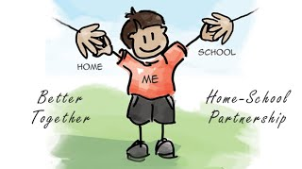
Active Supervision: Home-to-School Collaboration
Collaborating with families is vital in the successful implementation of Active Supervision.
It helps us learn about children as individuals and their unique characteristics and tendencies.
It promotes open communication on strategies that work at school, home, or both.
It encourages teamwork with families so that we are all on the same page as it relates to Active Supervision.

Slide 36
Sharing Active Supervision with Families
Collaborating with families with Active Supervision occurs all throughout the year:
Sharing information at Orientation along with the Parent Handbook.
Providing additional information and resources at Parent-Teacher Conferences, Home Visits, and in newsletters.
What other ways could you share Active Supervision with your families?
Resources:
Below is a helpful resources as it relates to Active Supervision and collaborating with families.
“A Guide to Safety Conversations with Families”

Slide 37
Active Supervision & Staff Wellness
Early Childhood Education is demanding work!
Some days life throws you curveballs:
You may struggle with changes in staffing;
You are pulled in a variety of directions dealing with challenging behaviors;
Or any other number of things that can happen on a given day!
Active Supervision NEVER takes a day, hour, or minute off!!
What are you doing to take care of YOU to stay on top of your Active Supervision game?

Slide 38
Staff Wellness Resources
Please watch this short video on the importance of mindfulness and staff wellness.

Slide 39
Staff Wellness Resources
NMCAA offers a variety of resources to support staff on their wellness journey.
Employee Assistance Program
Wellness Coach
Starling Minds
NONI
ECLKC also provides a variety of resources to explore.

Slide 40
Active Supervision Plan
Now that you’ve had time to become more familiar with Active Supervision, it’s time to examine how to intentionally plan and implement the Active Supervision strategies .
Please refer to the following slides for more information regarding Active Supervision postings and forms.

Slide 41
Active Supervision Postings
Active Supervision Poster
This poster should be displayed in an easily viewed location.
Need a new poster? Check here:
ECLKC

Slide 42
Active Supervision Postings
Active Supervision At-a-Glance
This posting offers a quick reference for the six Active Supervision strategies.
Need a new poster? Check here:
ECLKC

Slide 43
Active Supervision Plan: An Overview
The next several slides provide an overview of the Active Supervision Plan contents:
Zoning to Maximize Learning: Discussion Questions
Zoning to Maximize Learning: Staff Zoning Chart
Active Supervision Implementation Plan
Classroom Maps: Indoor & Outdoor Spaces
Classroom Transitions: Planning for Transitions
These forms are completed as a team and updated throughout the year, as needed.

Slide 44
Zoning Discussion Questions
These questions are used to create a dialogue with your team regarding the creation of zones in your learning environment.
Remember….how things looked in the past could look completely different this year! Flexibility is key!

Slide 45
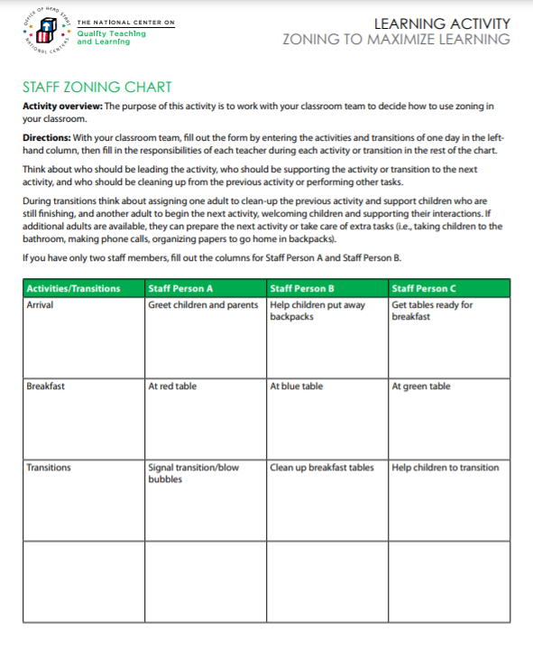
Staff Zoning Chart
Creating a zoning chart is an intentional practice to encourage children’s learning and keep them safe!
Pull out your daily schedule for reference. Think about what each staff person will be doing during each part of the daily routine. Pay close attention to transitions. Document your plan on the Staff Zoning Chart form.

Slide 46
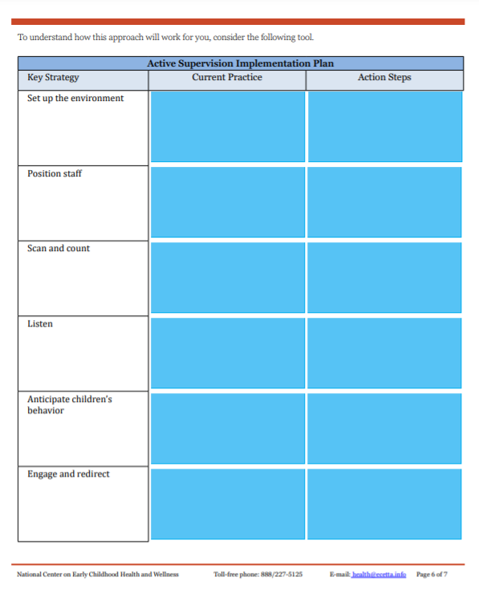
Implementation Plan
This form is used to reflect on the six Active Supervision strategies and the practices used in the past.
What went well? Were there challenges? What changes might need to be implemented?
Points and ideas are noted on the Active Supervision Implementation Plan form.

Slide 47
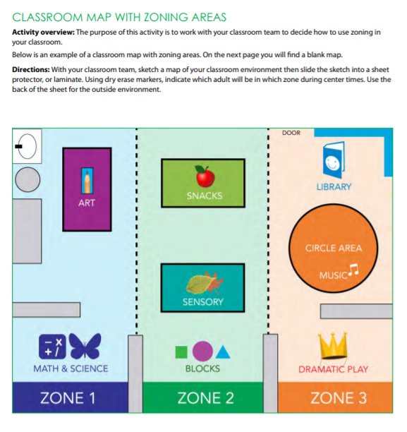
Classroom Map
Complete a zoning map for both your indoor and outdoor spaces.
Refer to the example included on this slide.
You can use the maps already created for Licensing!
Tip: Place your map(s) in a sheet protector and assign zones with a dry erase marker (quick and easy changes!).

Slide 48
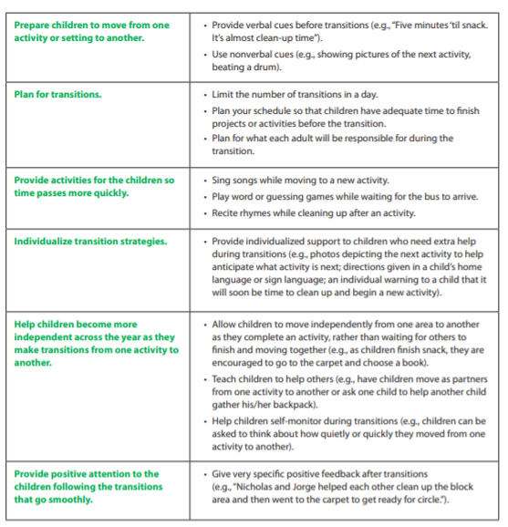
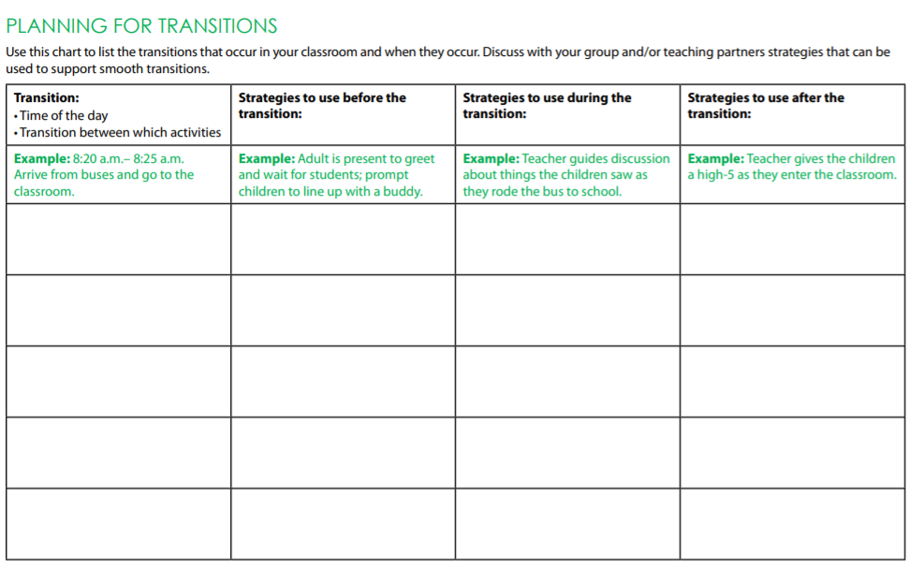
Planning for Transitions
Review the transition tip sheet included on this slide as you prepare to complete the Planning for Transitions form.
Have your daily schedule handy as you think about and plan for the variety of transitions throughout the day.
Who will be where?
What strategies and activities will you use?
How will you individualize your transition activities?
How will you promote independence in all children?

Slide 49
Please refer to these additional resources while completing your Active Supervision plan:
Tips for Teachers: Classroom Transitions
Tips for Teachers: Zoning to Maximize Learning
Active Supervision Toolkit
Tips for Teachers: Designing Environments
Tools for Supervisors: Supporting Positive Behaviors During Classroom Transitions
ECLKC

Slide 50
Active Supervision: Final Thoughts
We are ALL responsible for the health and safety of ALL children while they are in our care.
Active supervision is a critical piece to ensuring that ALL children have opportunity to explore and learn in a caring, responsive, and safe environment!
Creating an Active Supervision Plan is an intentional process that should include everyone on the team.
Be sure to place your completed Active Supervision Plan in a place easily accessible to all staff, including substitutes.
Reminder: As the year goes along, changes are sure to happen! Pull out your Active Supervision Plan to review and make adjustments, as needed.

Slide 51
Final Training Steps
Complete a Professional Development Participation Log
CLICK HERE for a copy of the PD log for this training or scan the QR code included on this slide.
Complete the Professional Development Survey on the following slide.
Upon completion of the survey, you will be entered into a roster on MiRegistry.
This training will appear on your learning record.
Need the PD survey direct link? CLICK HERE

Slide 53
References
““Active Supervision Presentation Produced.” YouTube, uploaded by Michelle Fitzsimmons, 19 April 2016, Active Supervision Presentation Produced – YouTube.
“Classroom Transitions.” YouTube, uploaded by usgovACF, 20 July 2015, https://www.youtube.com/watch?v=5SCCRIOEahs.
“Maintaining Accountabiilty.” Uploaded by Virtual Lab School, https://stream.virtuallabschool.org/safety/3074/3074-480.mp4.
“PBIS Active Supervision.” YouTube, uploaded by John Beach, 17 Jan. 2012, https://www.youtube.com/watch?v=sxwl_TiB1xU.
“Preschool from a two year olds view point.” YouTube, uploaded by Katie Stauffer, 11 Aug. 2017, https://www.youtube.com/watch?v=jtnOCRBku7s2.
“Supervision: Positioning – Where Do I Stand?” YouTube, uploaded by Better Kid Care, 1 Sept. 2015, https://www.youtube.com/watch?v=Z8ewYm_DuEM.
“Supervision: What’s the Count?” YouTube, uploaded by Better Kid Care, 1 Sept. 2015, https://www.youtube.com/watch?v=_3Yhc9JT88s.

Slide 54
THE END!
Thanks for all you do for young children. A big thanks for your commitment to keeping all children safe while in your care!!

